Slide 1
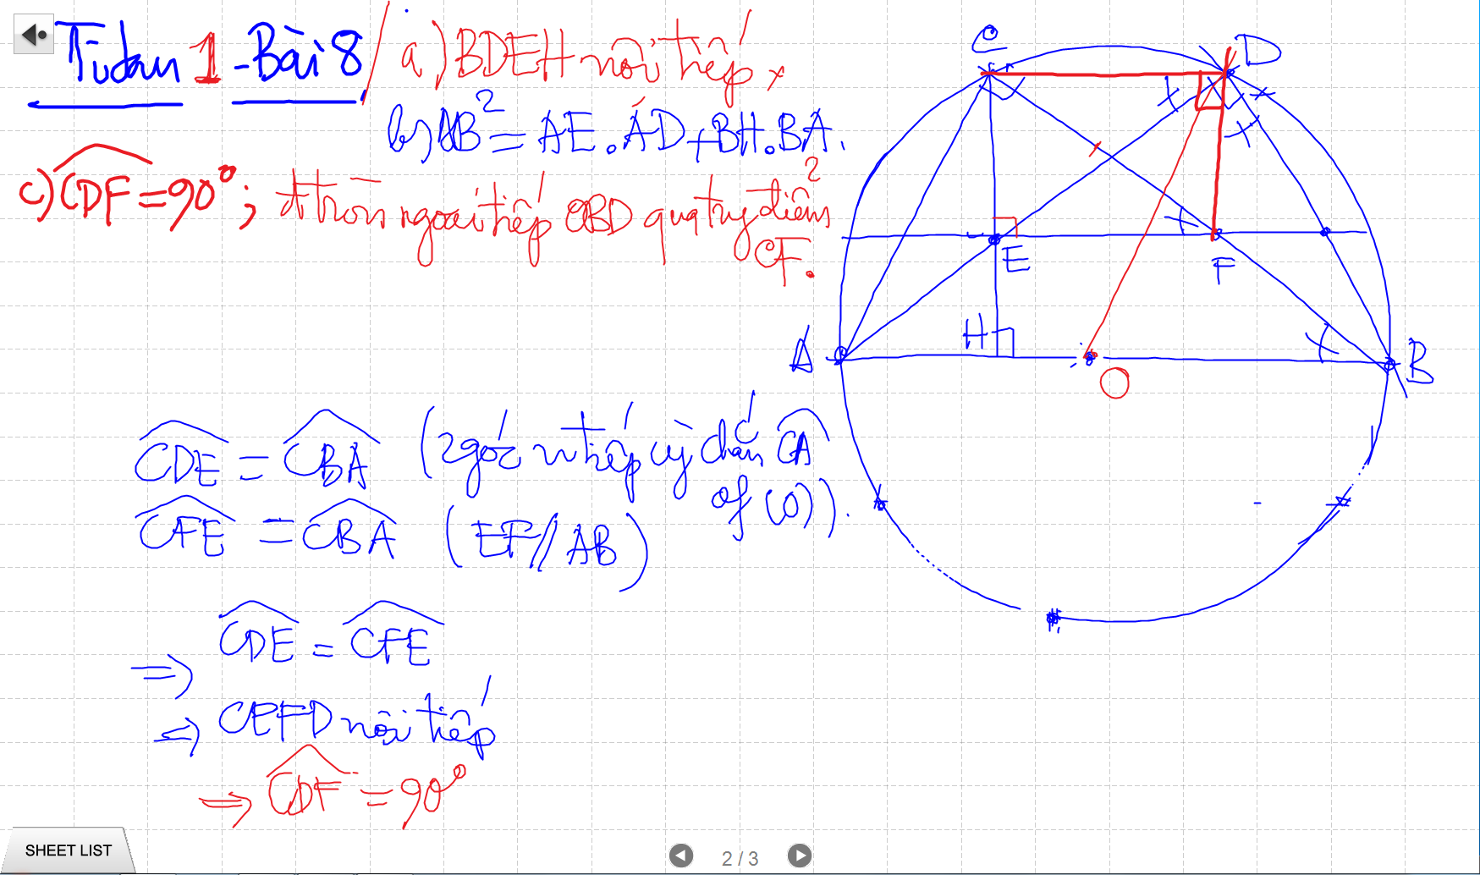
C/m tam giac dong dang truong hop 2

Slide 2
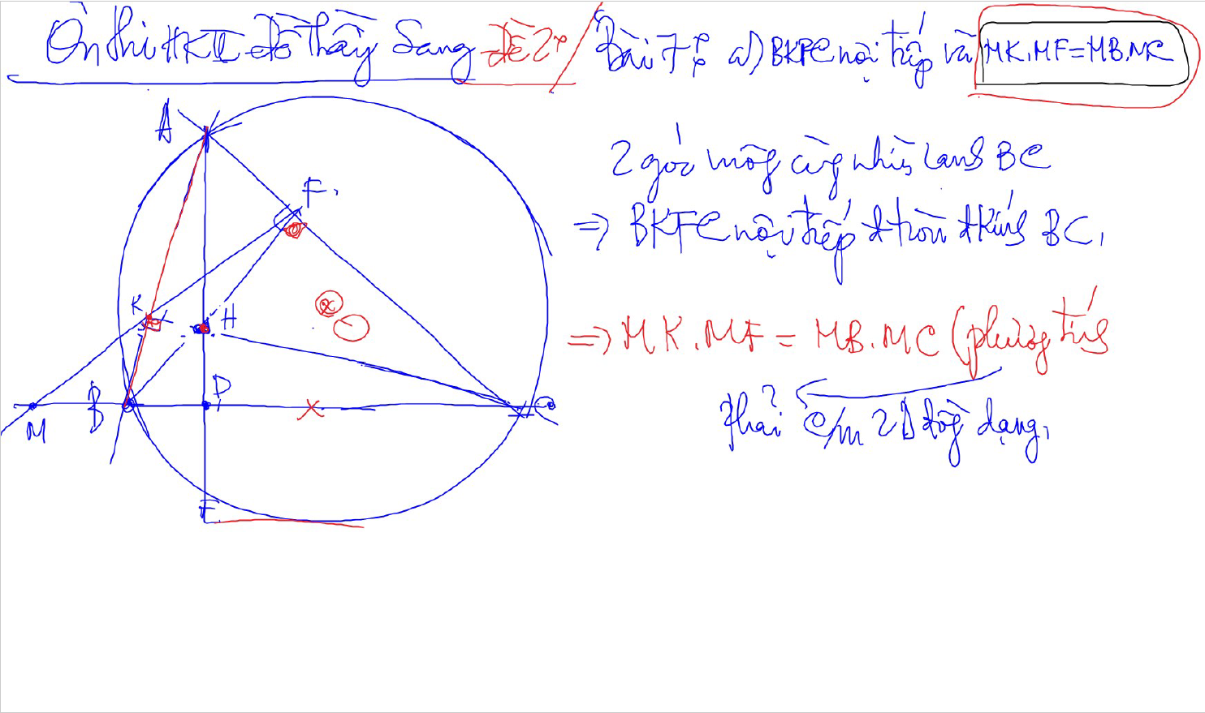
C/m tam giac dong dang truong hop 2

Slide 3
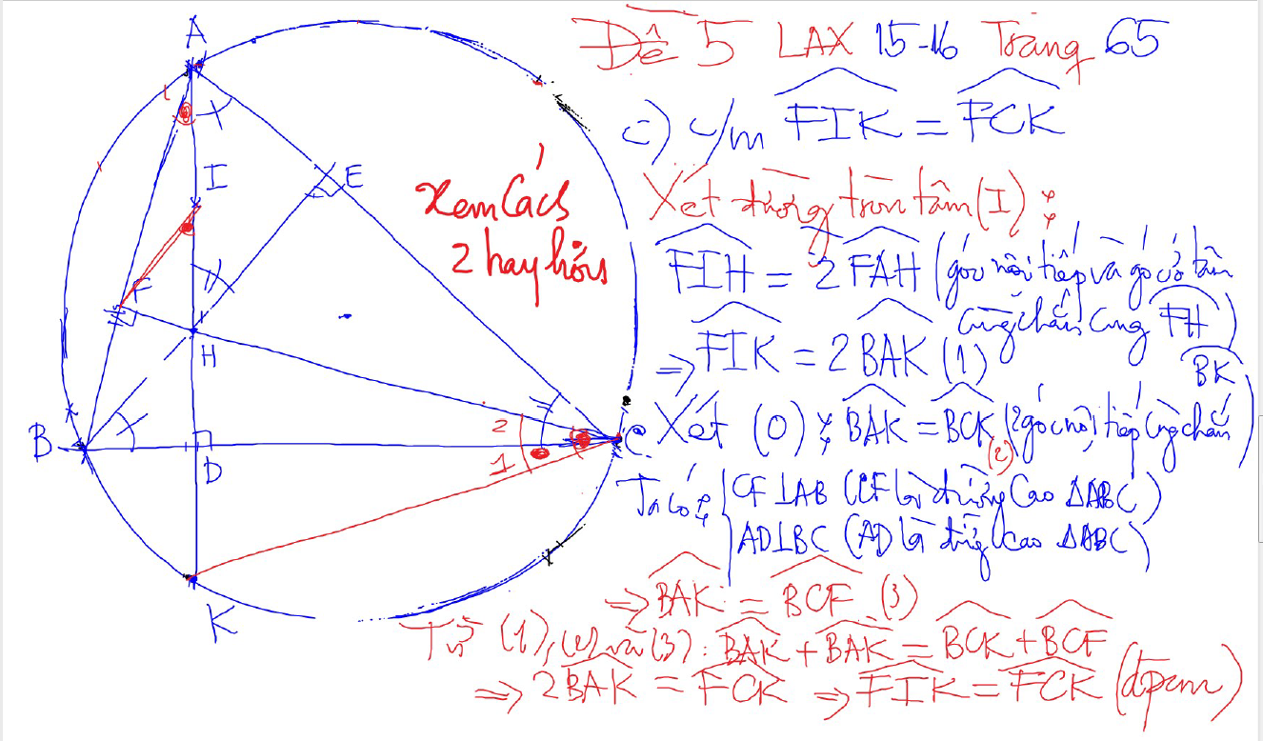
DUONG THANG SIMSON – Ap Dung

Slide 4
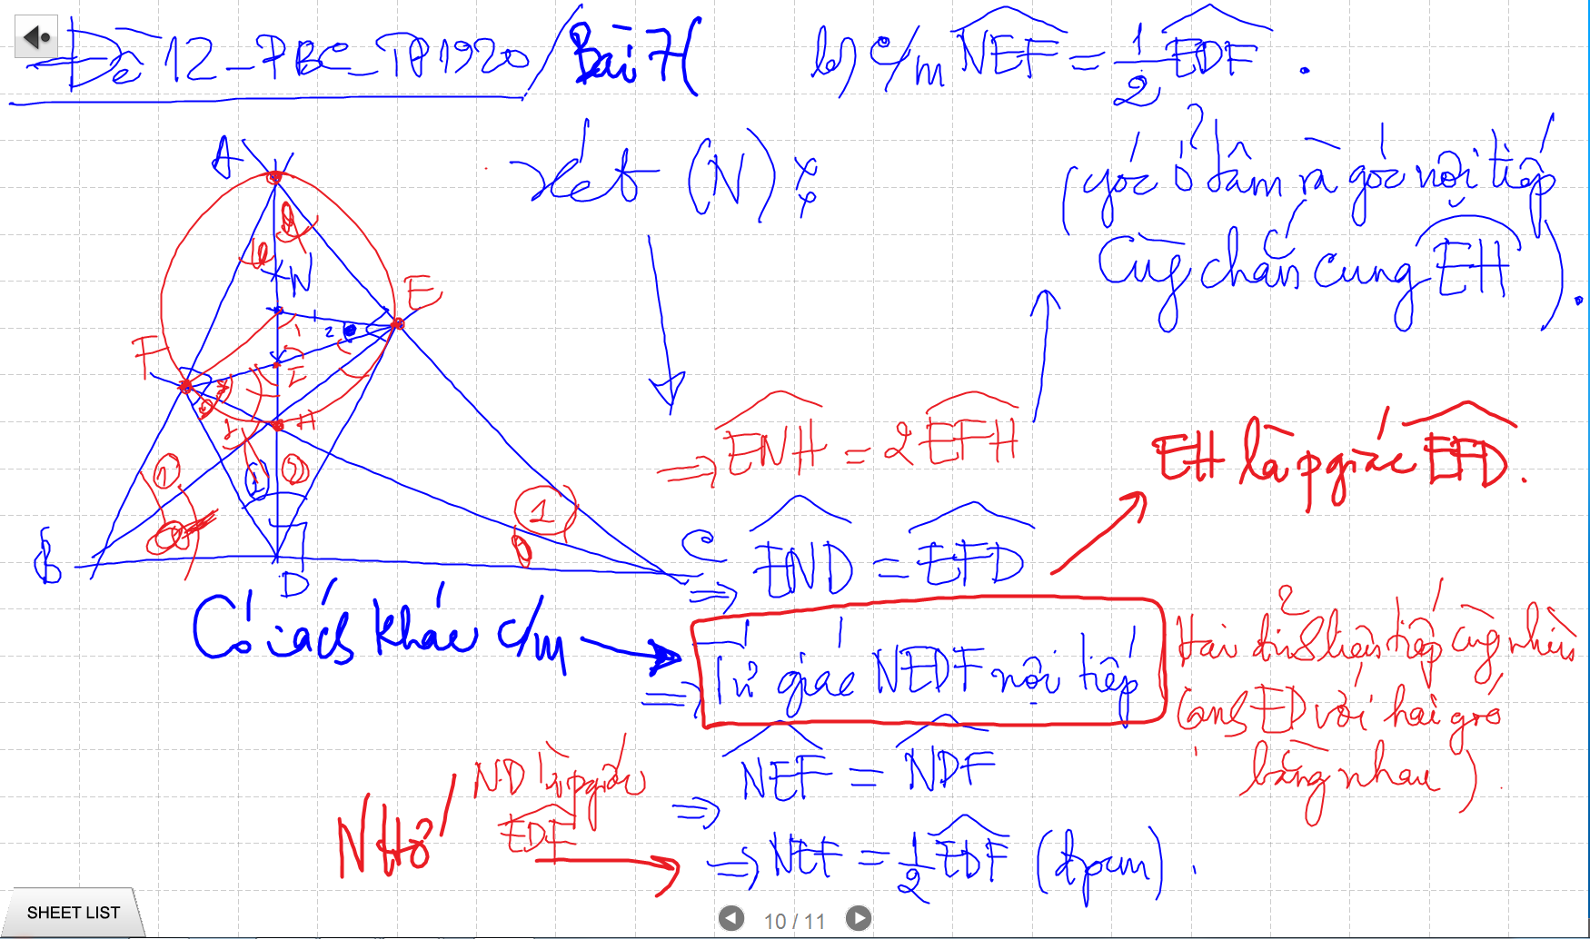
CM TU GIAC NOI TIEP -> SUY RA CAC GOC BANG NHAU

Slide 5
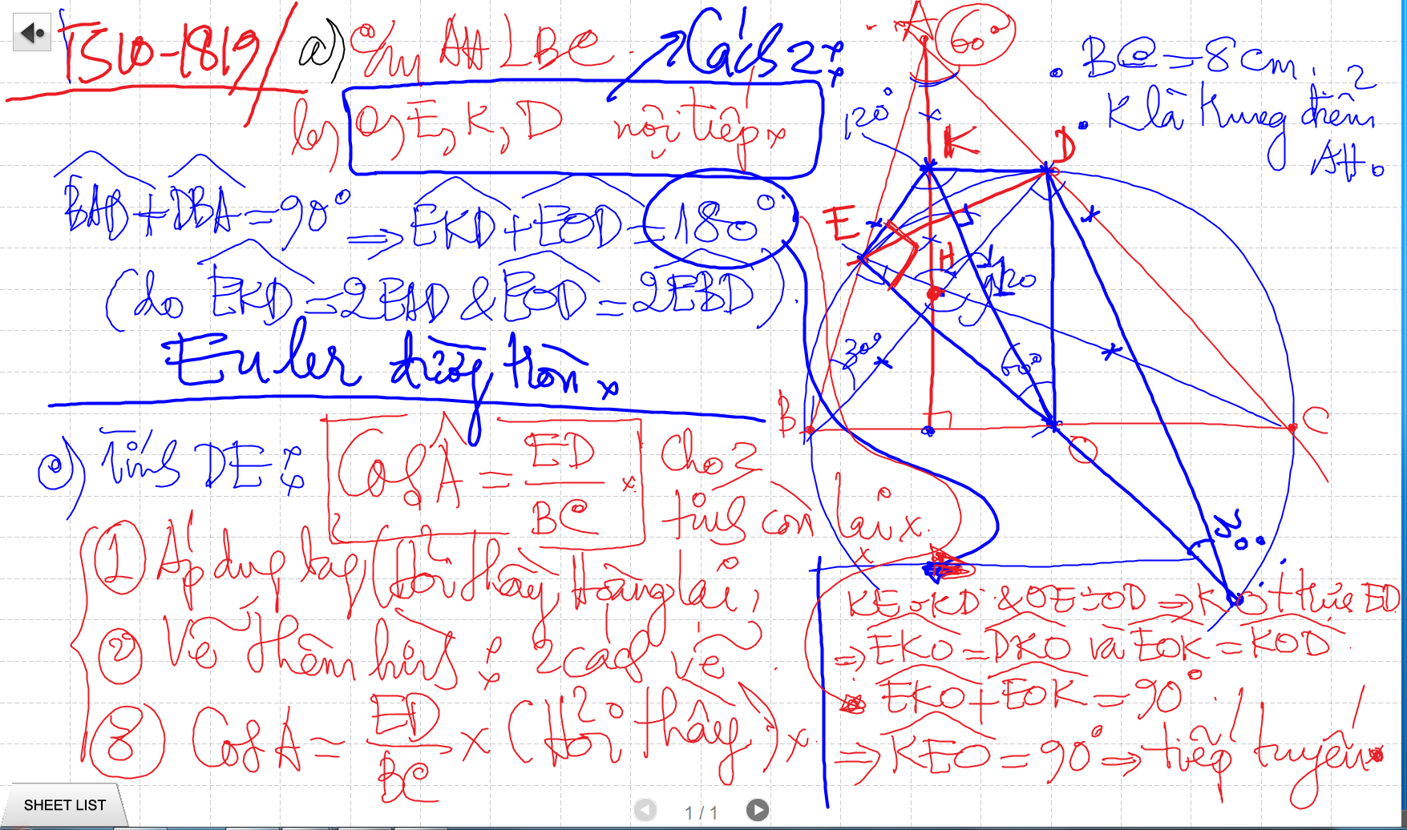
Bai 53 De Cuong – Euler

Slide 6
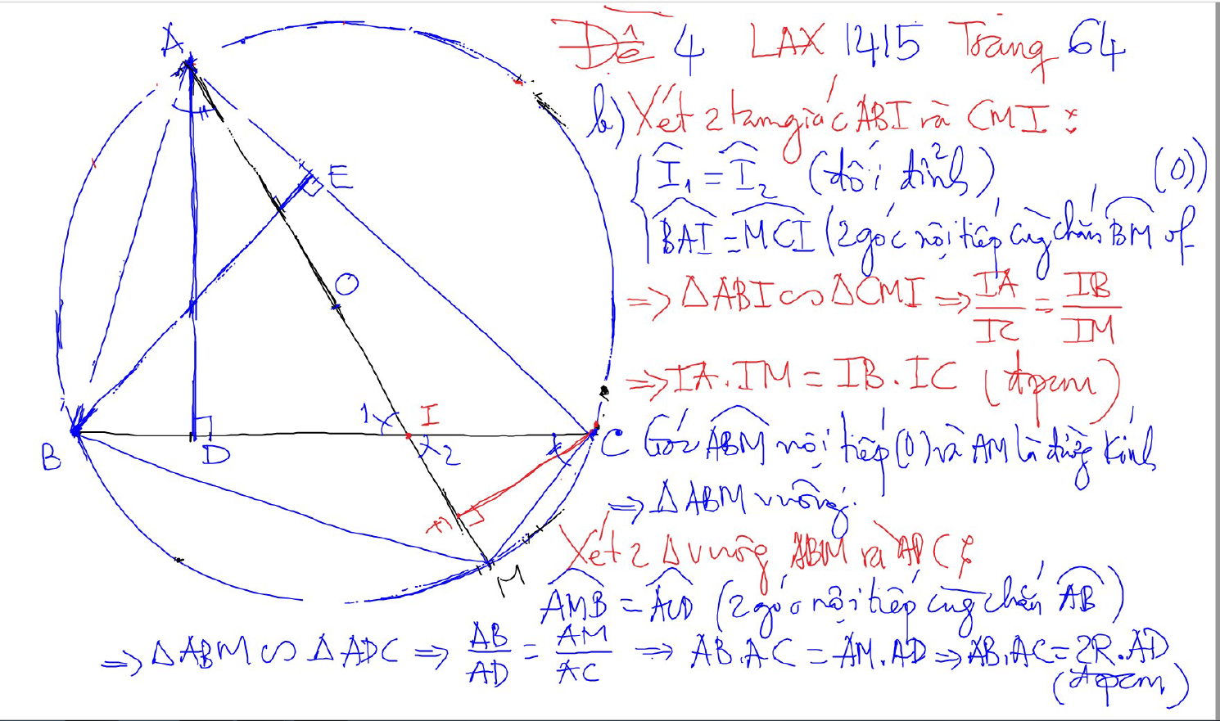
PHUONG TICH DIEM TRONG DUONG TRON

Slide 7
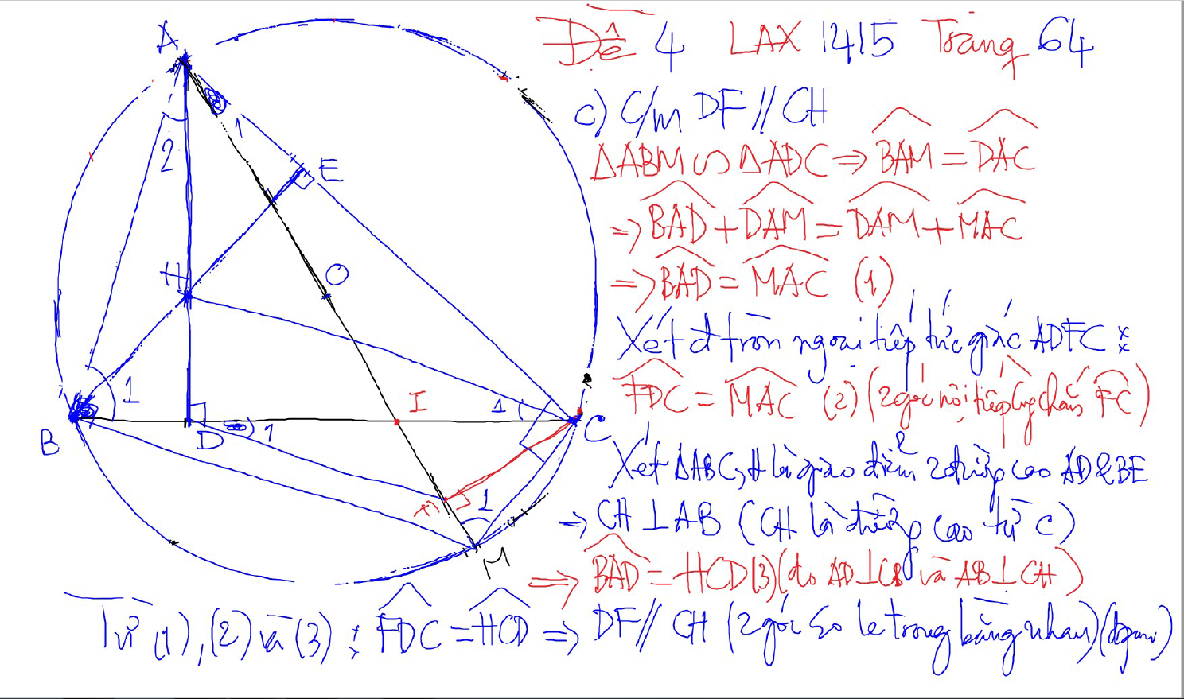
PHUONG TICH DIEM TRONG DUONG TRON

Slide 8
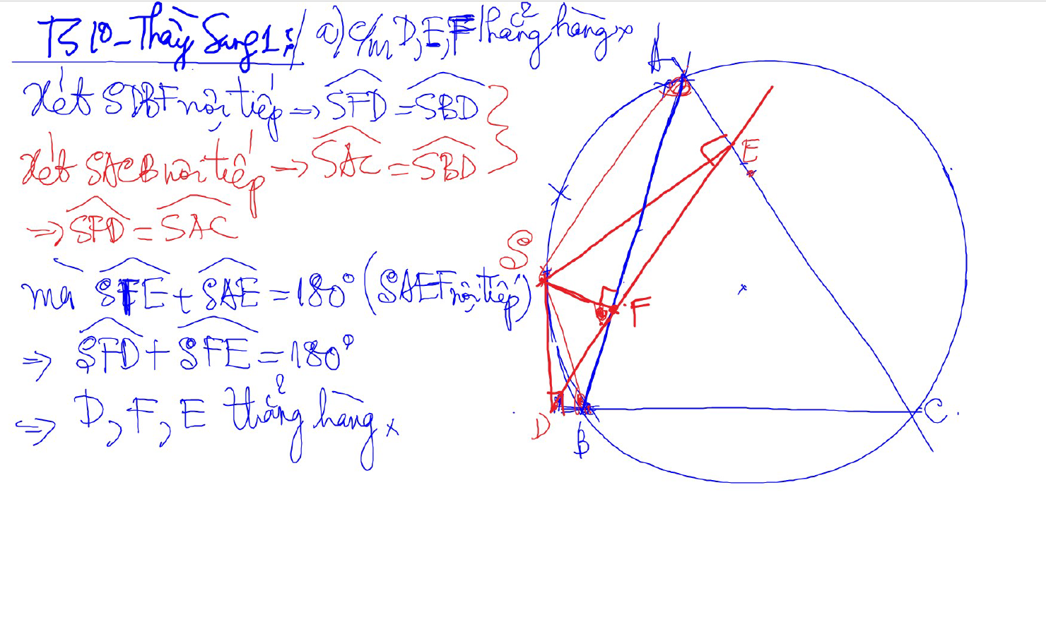
Đường thẳng SIMSON

Slide 9
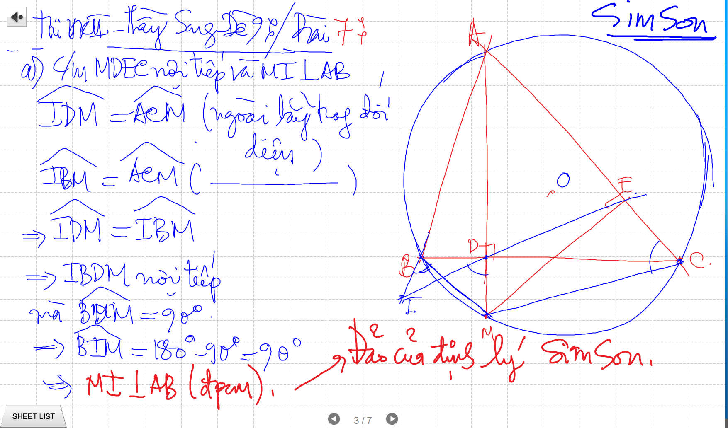
SIMSON

Slide 10
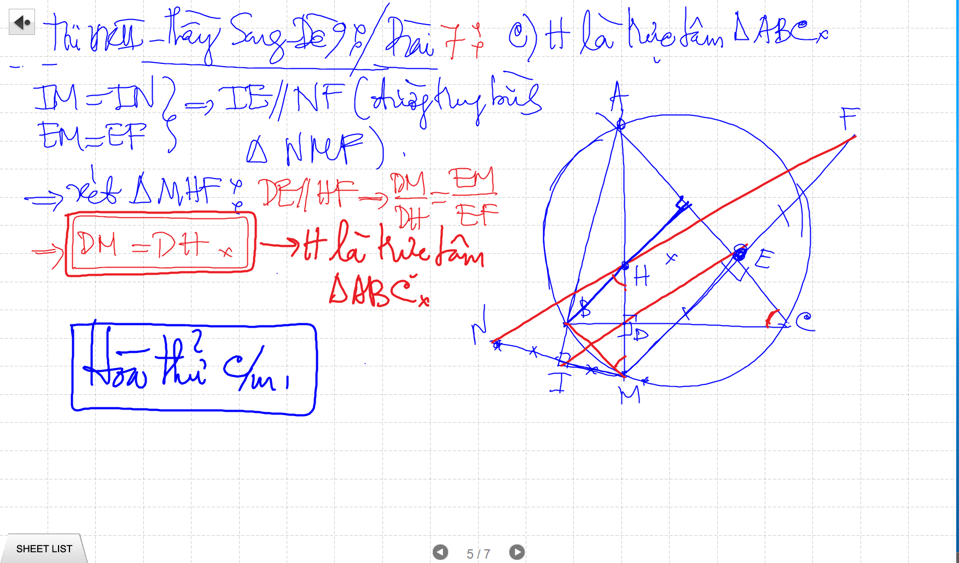
SIMSON

Slide 11
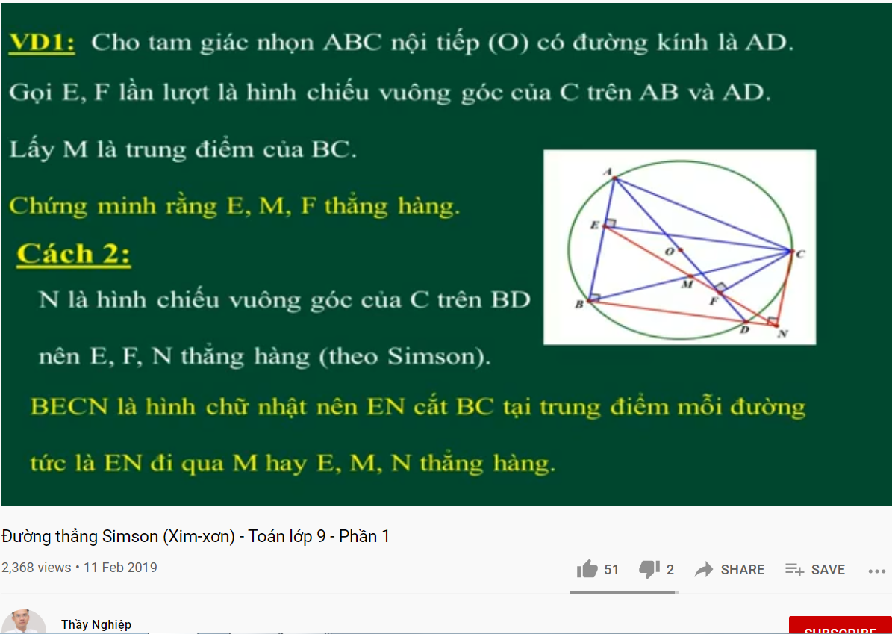
DUONG THANG SIMSON – Ap Dung

Slide 12
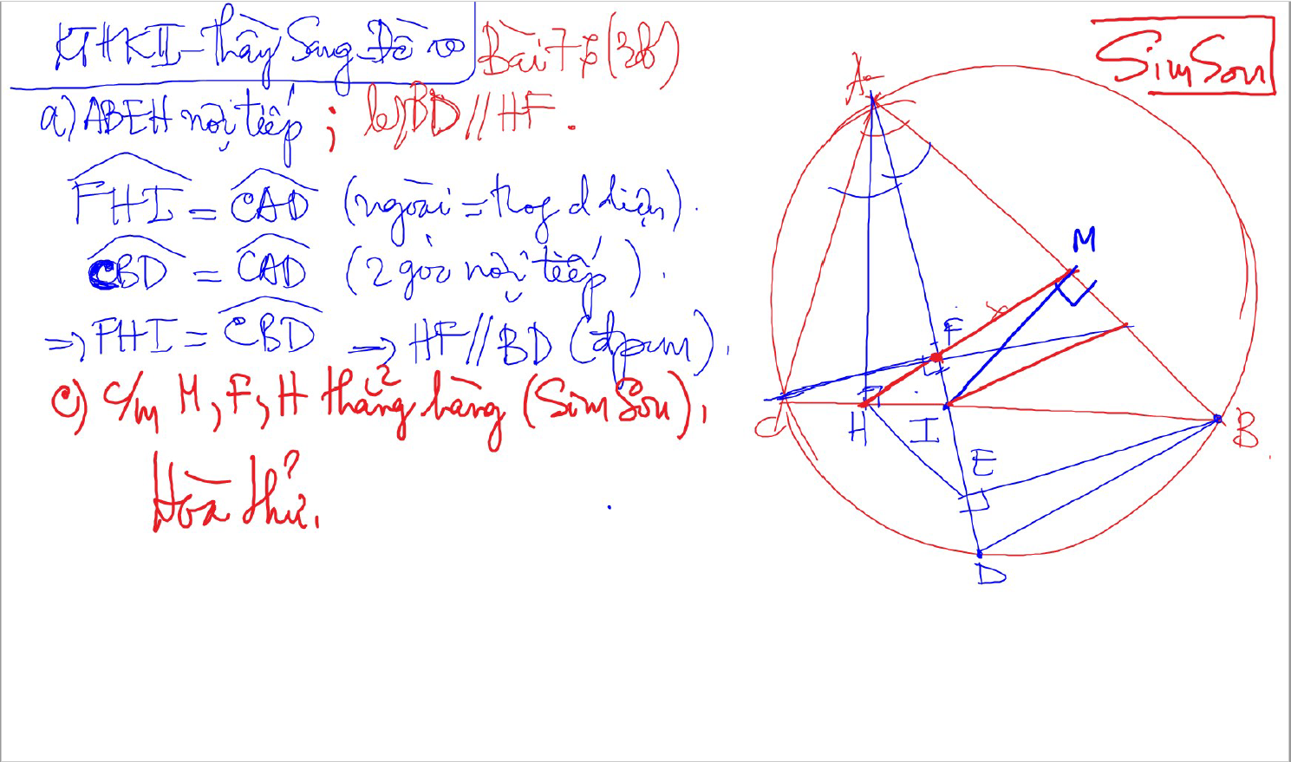
SIMSON

Slide 13
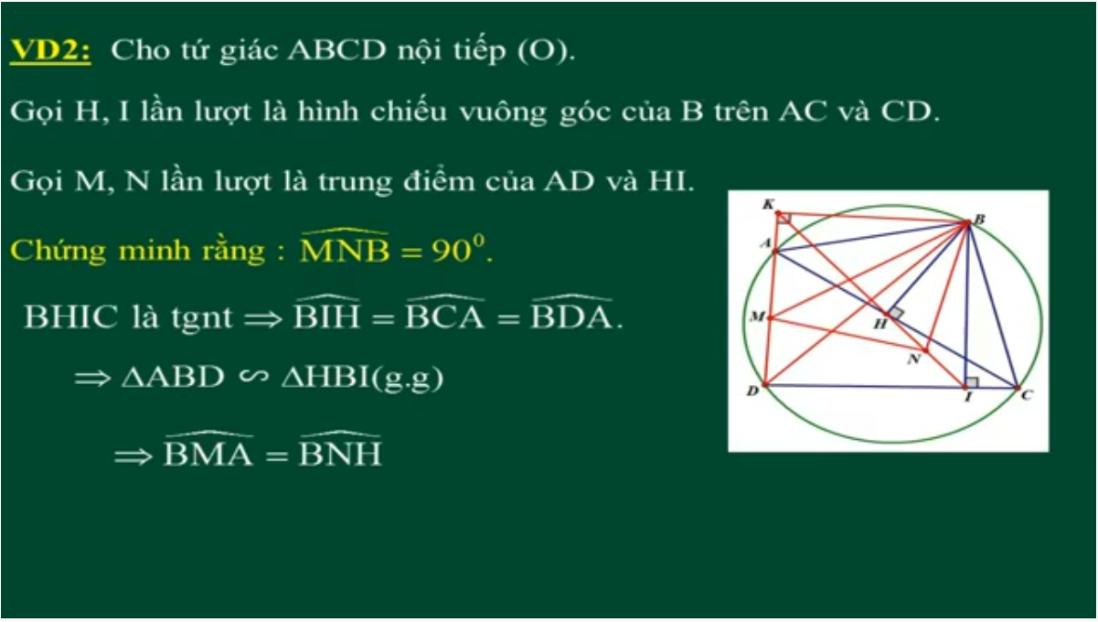
DUONG THANG SIMSON – Ap Dung

Slide 14
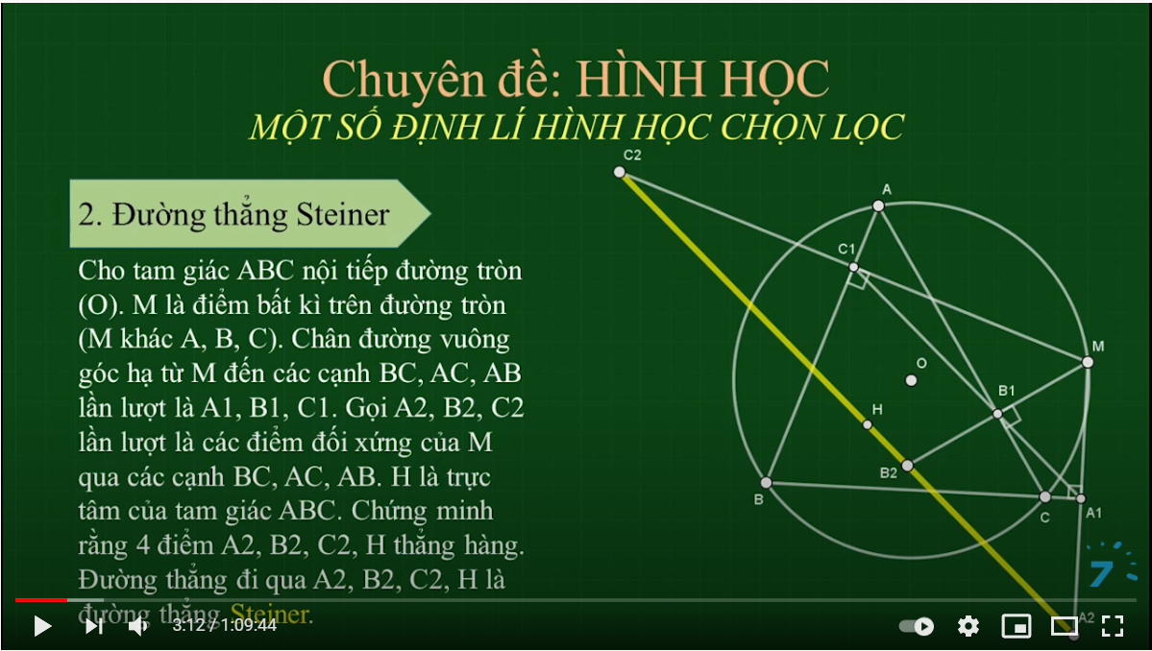
SIMSON

Slide 15
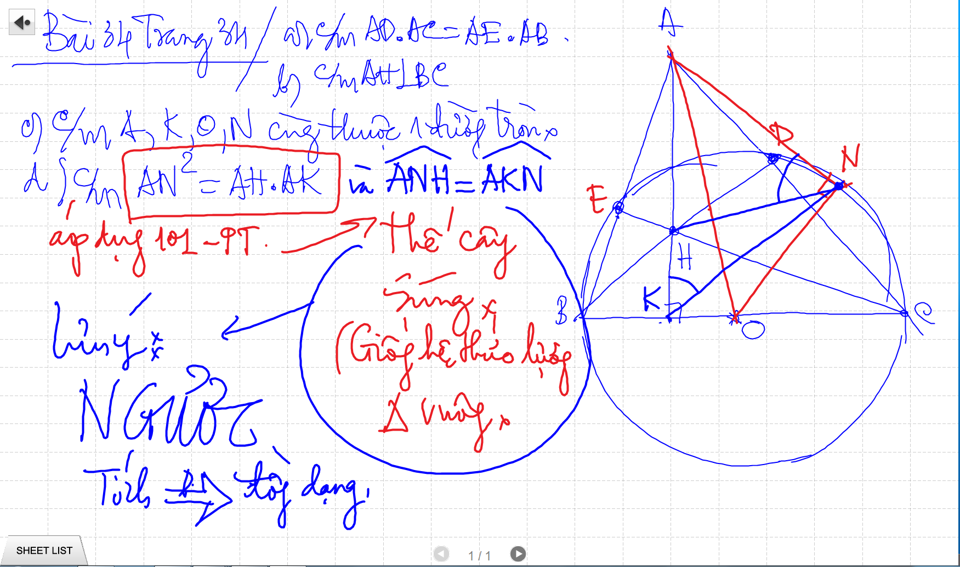

Slide 16
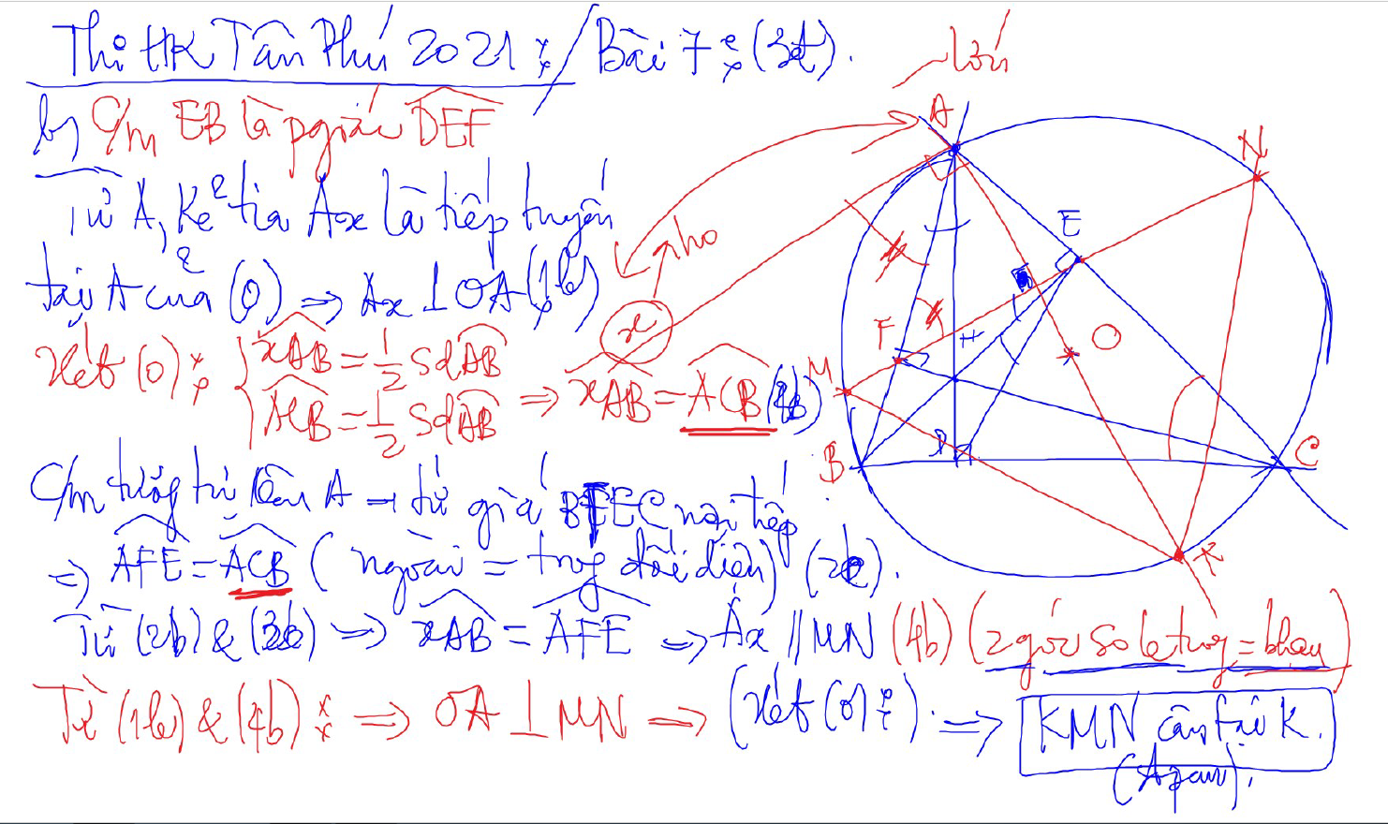
C/m tam giac dong dang truong hop 2

Slide 17
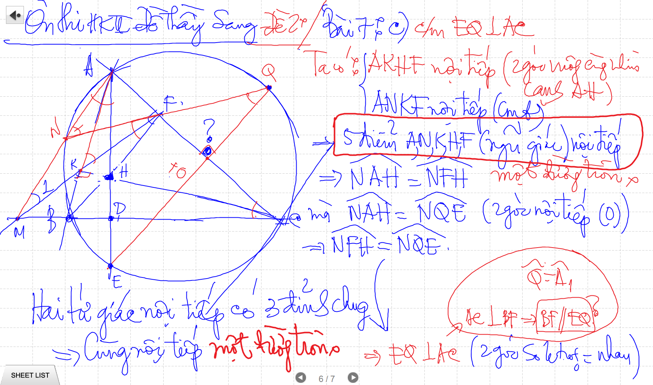

Slide 18
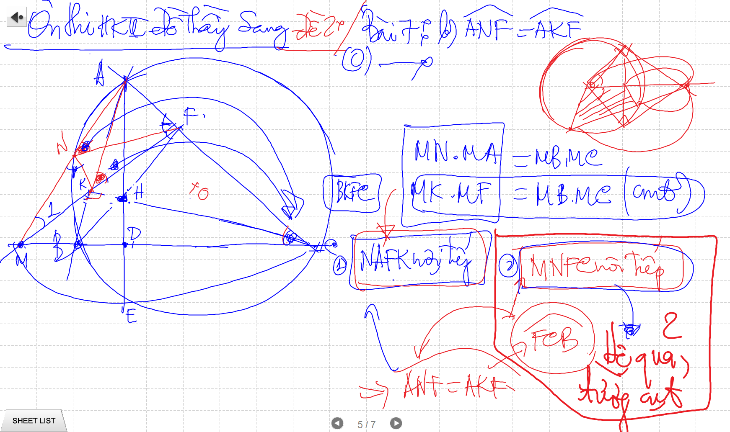
C/m tam giac dong dang truong hop 2

Slide 19
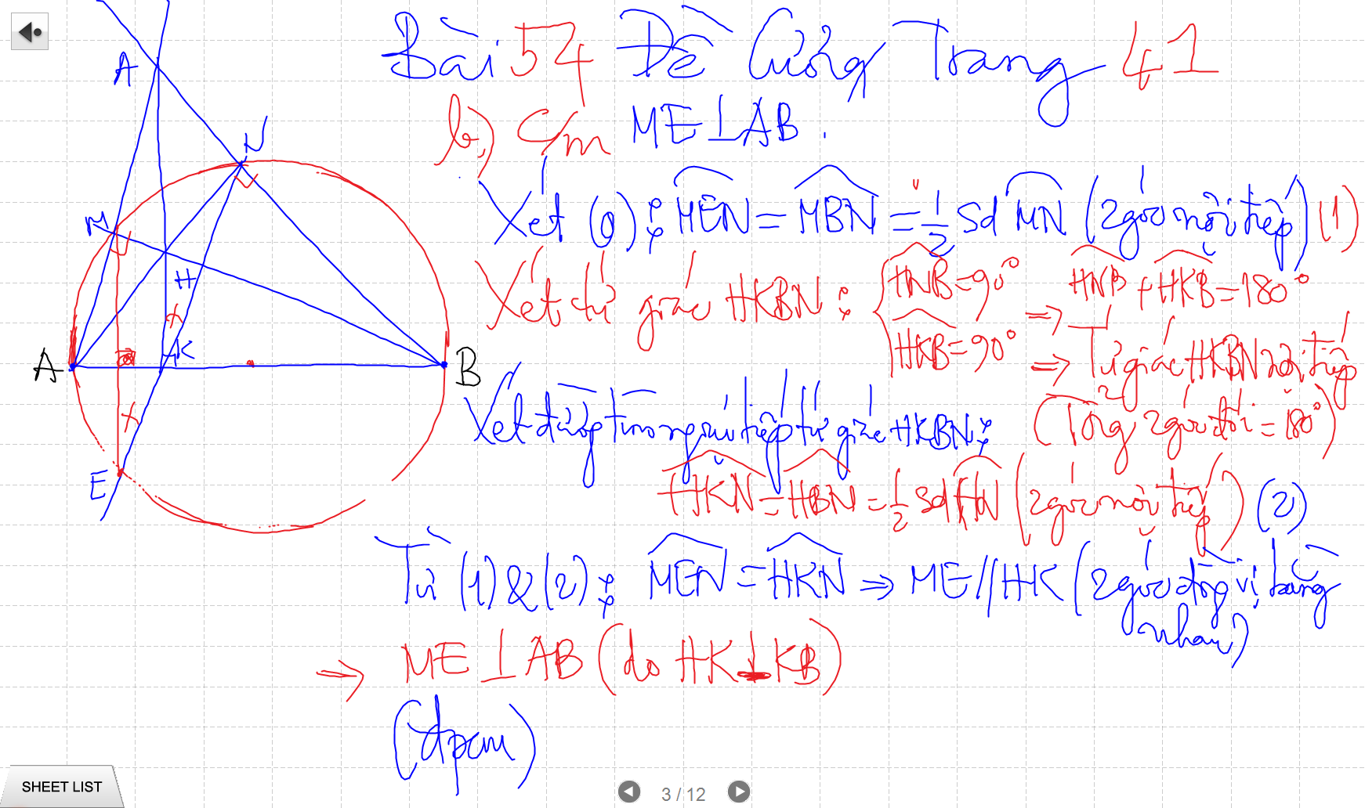

Slide 20
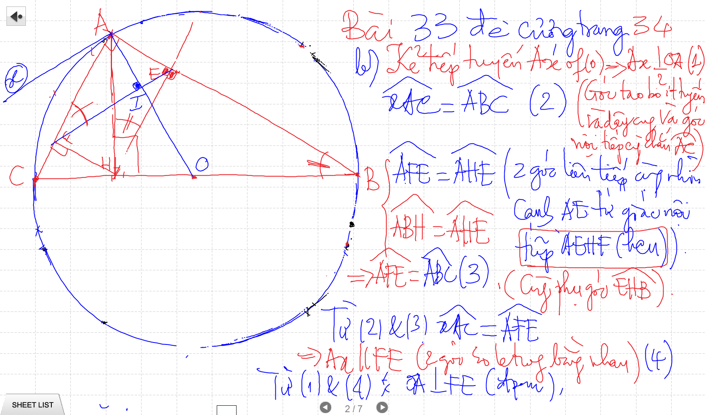
C/m tam giac dong dang truong hop 2

Slide 21
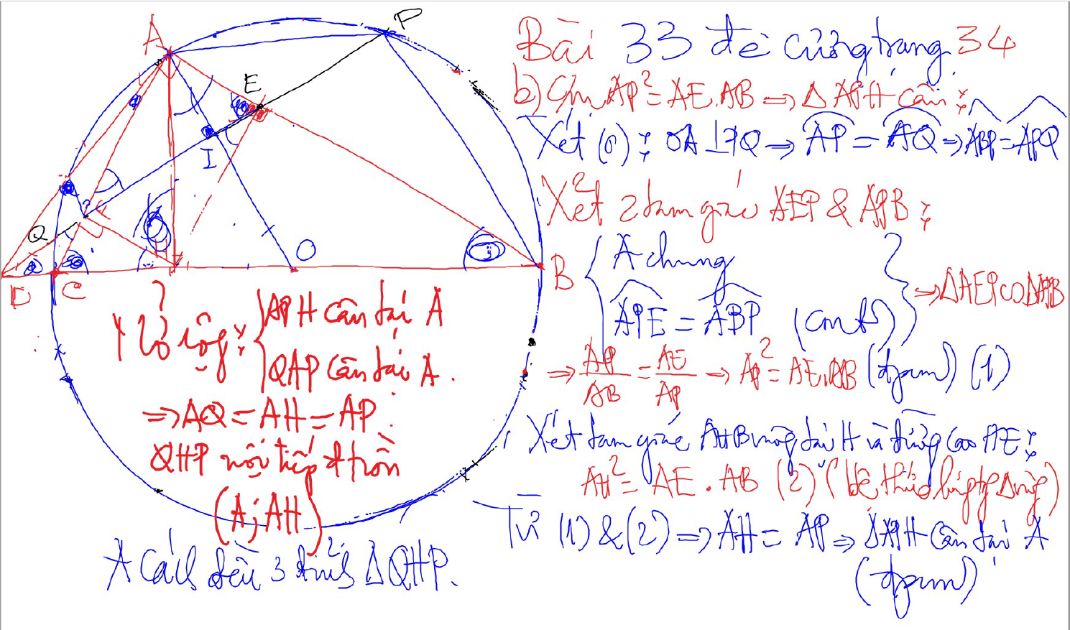
Bai 53 De Cuong – Kinh dien tam giac nhon 1 (xem trong thu muc Tu Giac Noi Tiep)

Slide 22
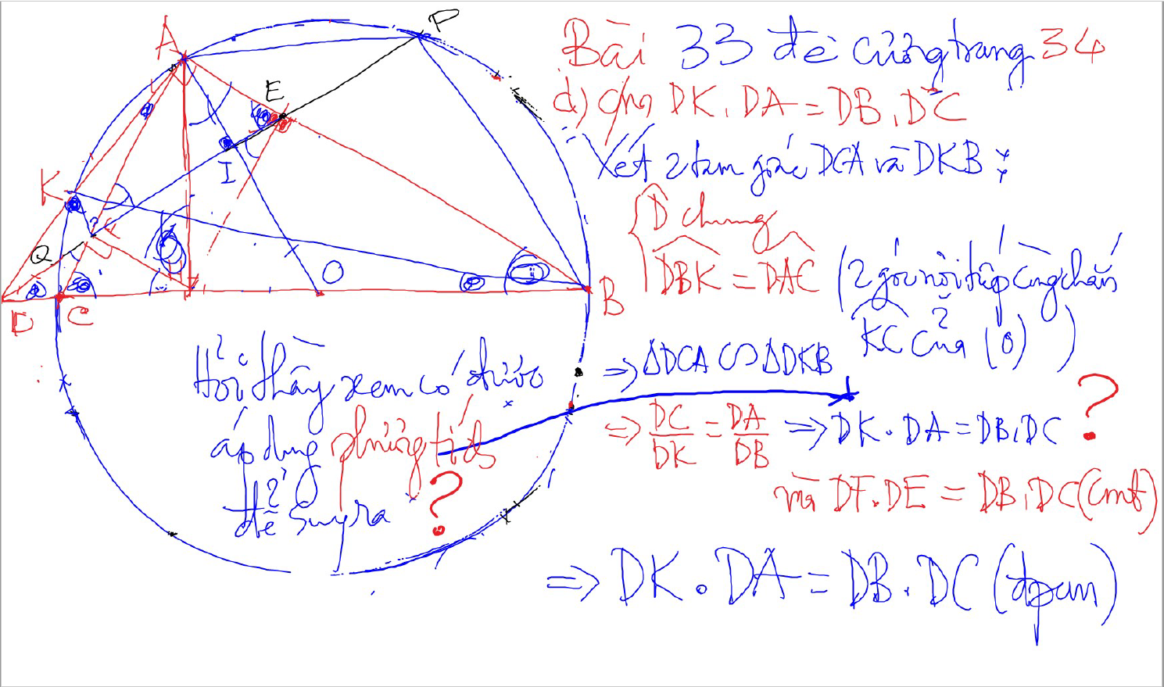
C/m tam giac dong dang truong hop 2

Slide 23
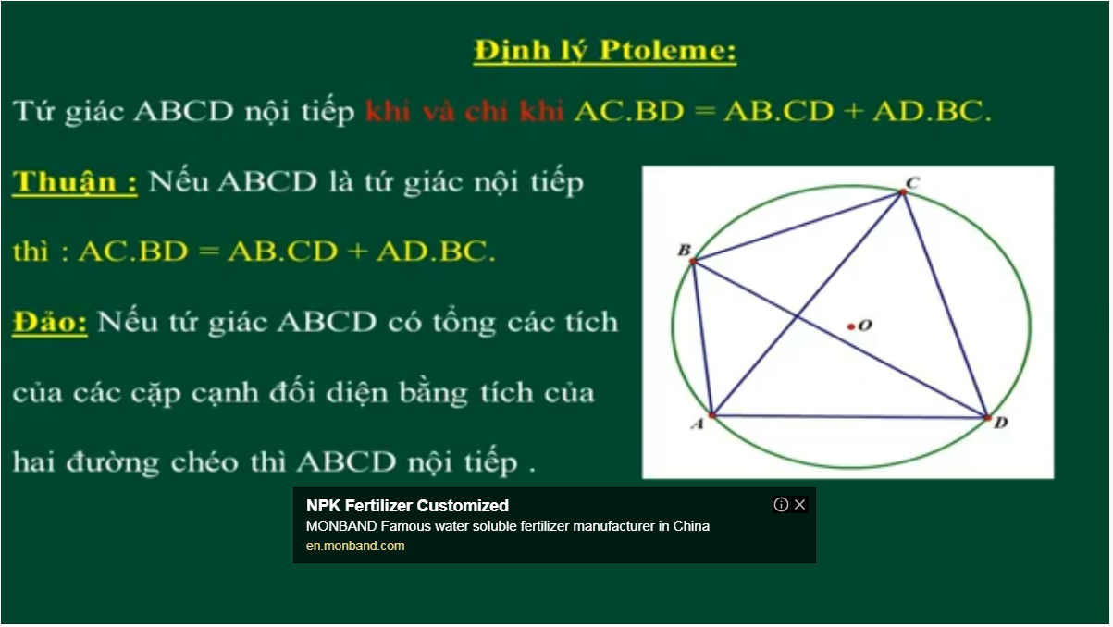
Bai 54 De Cuong – Kinh dien tam giac nhon 1 (xem trong thu muc Tu Giac Noi Tiep)

Slide 24
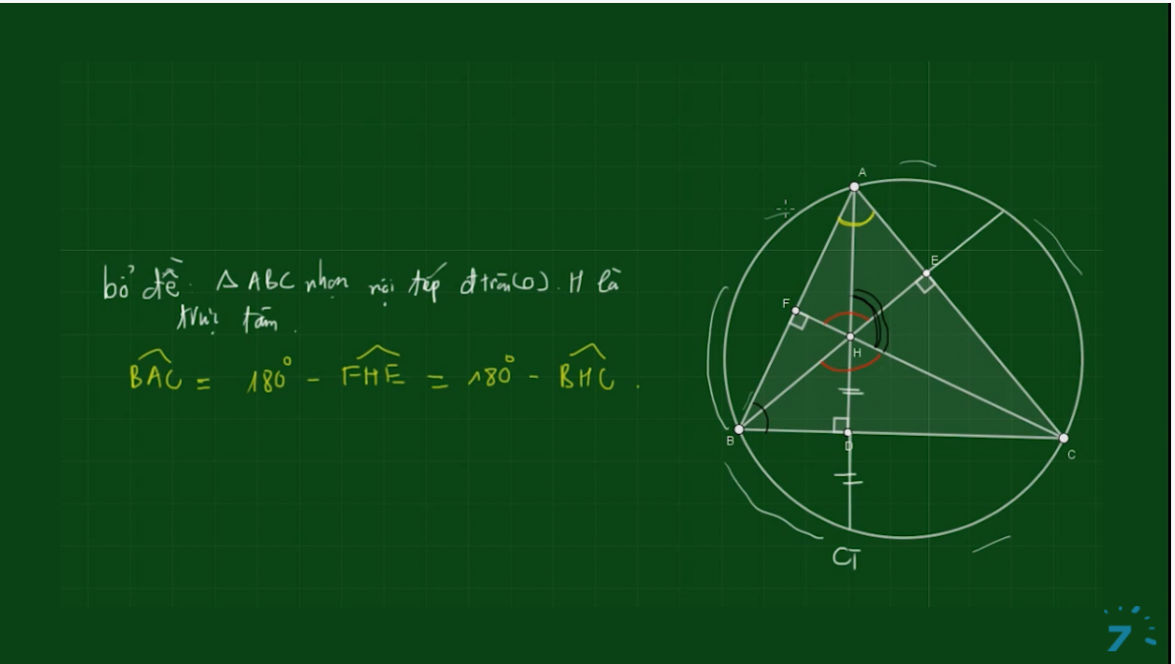
Bai 54 De Cuong – Kinh dien tam giac nhon 1 (xem trong thu muc Tu Giac Noi Tiep)

Slide 25
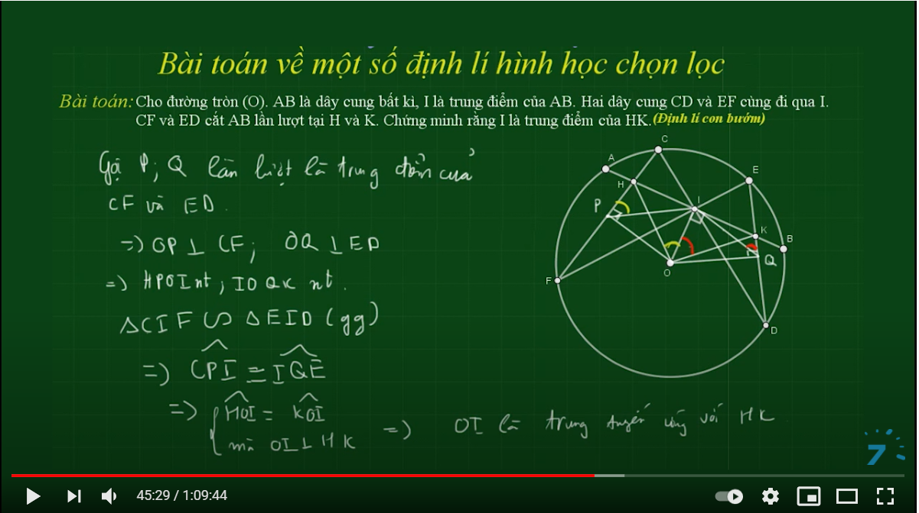

Slide 26
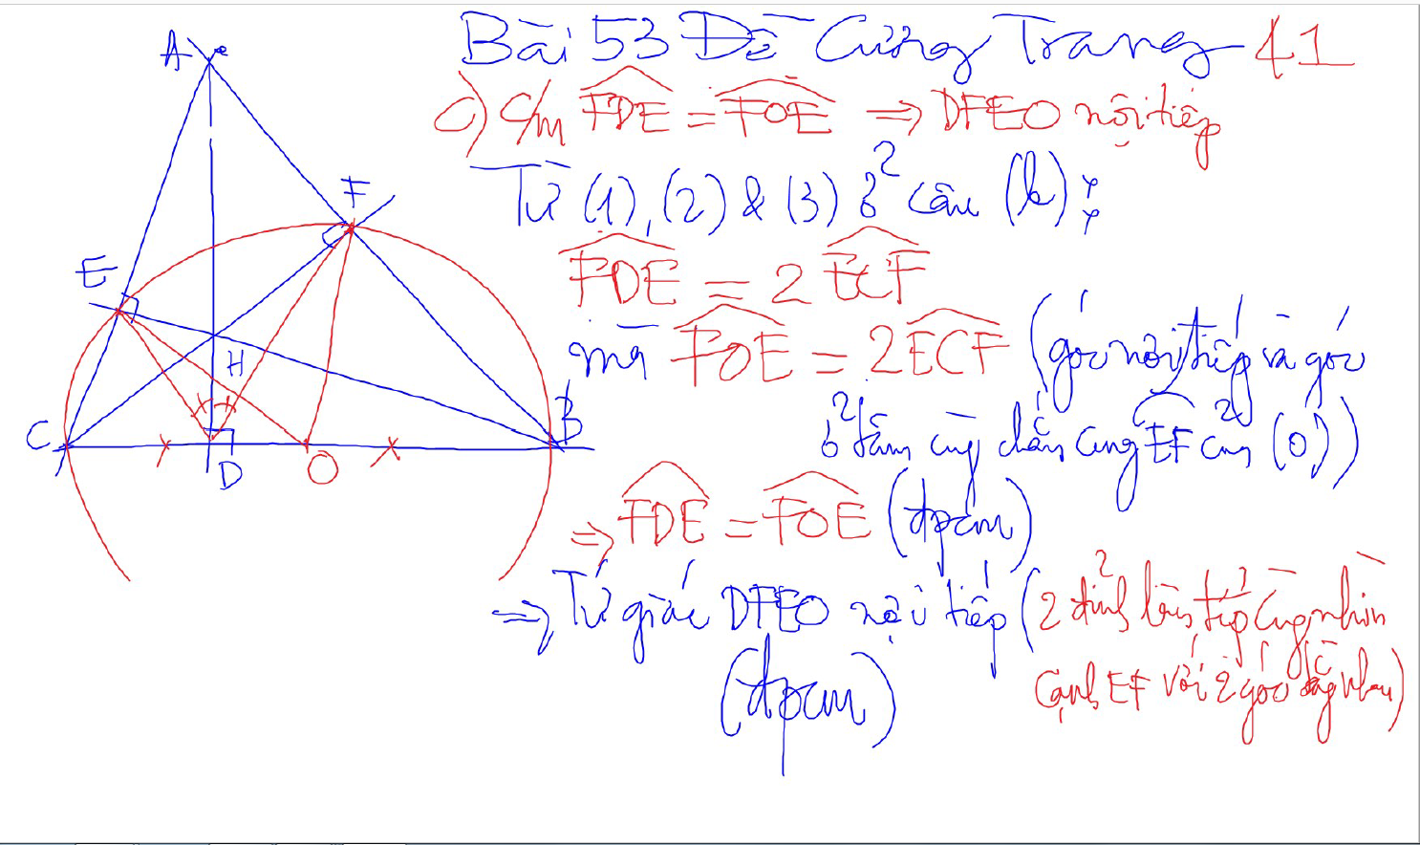
Bai 53 De Cuong – Kinh dien tam giac nhon 1 (xem trong thu muc Tu Giac Noi Tiep)

Slide 27
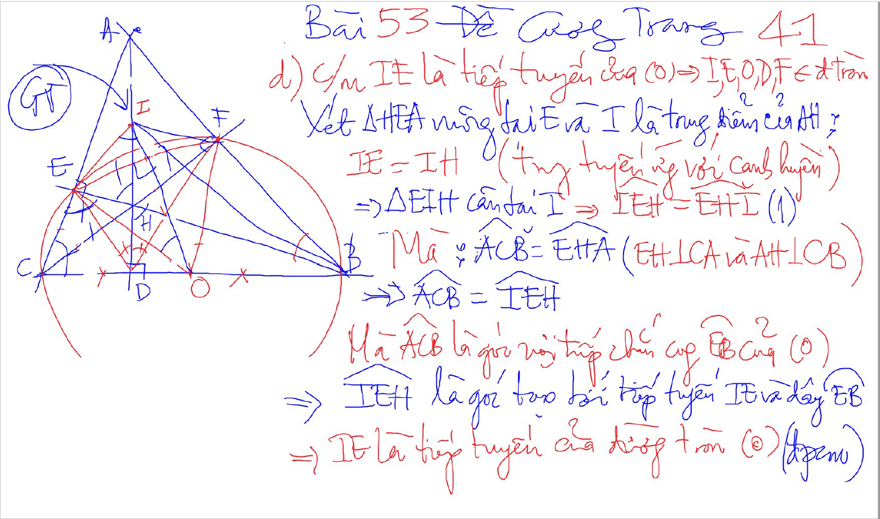
Bai 53 De Cuong – Kinh dien tam giac nhon 1 (xem trong thu muc Tu Giac Noi Tiep)

Slide 28
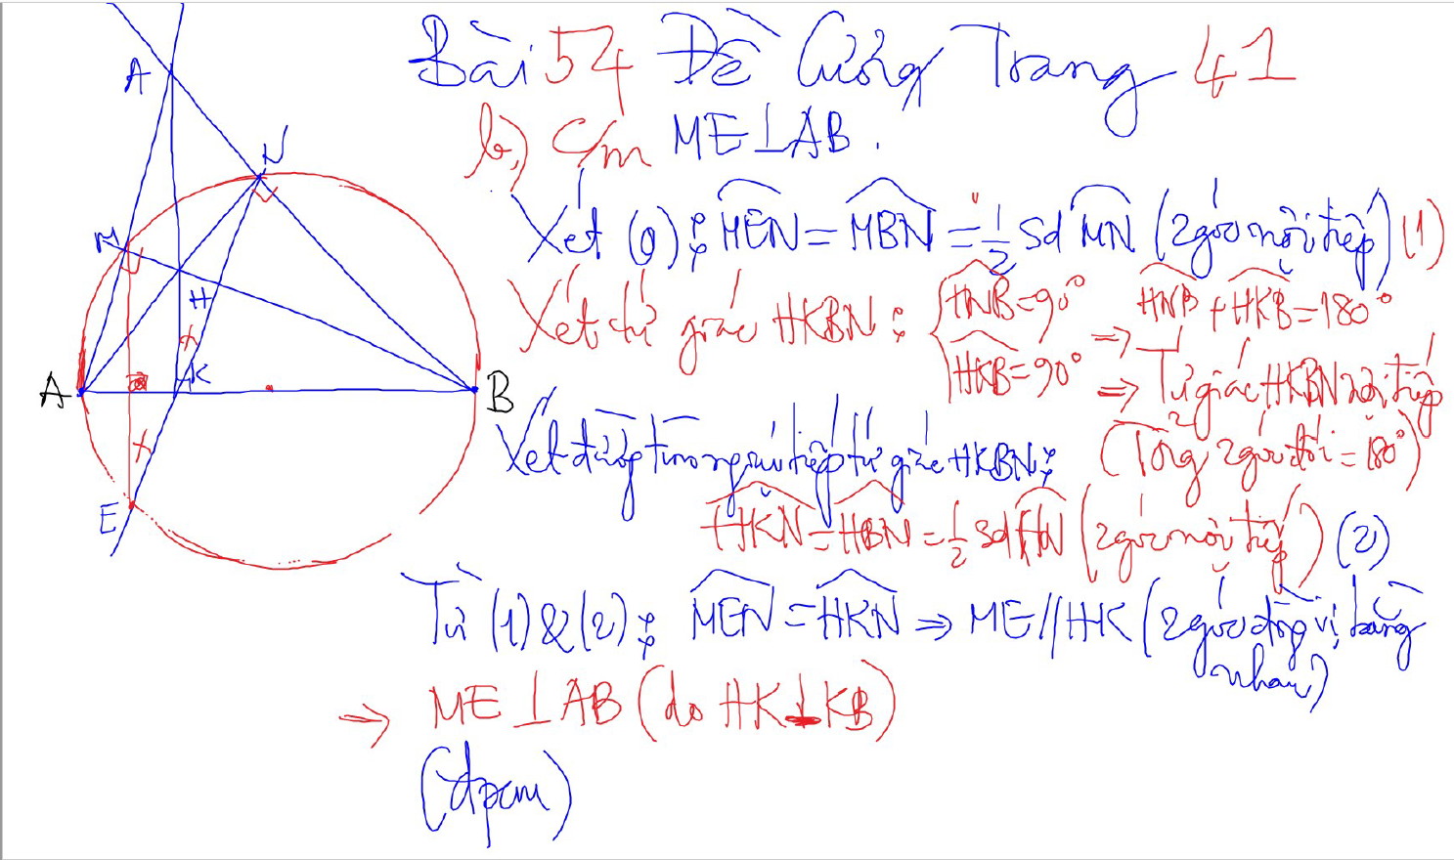
Bai 54 De Cuong – Kinh dien tam giac nhon 1 (xem trong thu muc Tu Giac Noi Tiep)

Slide 29
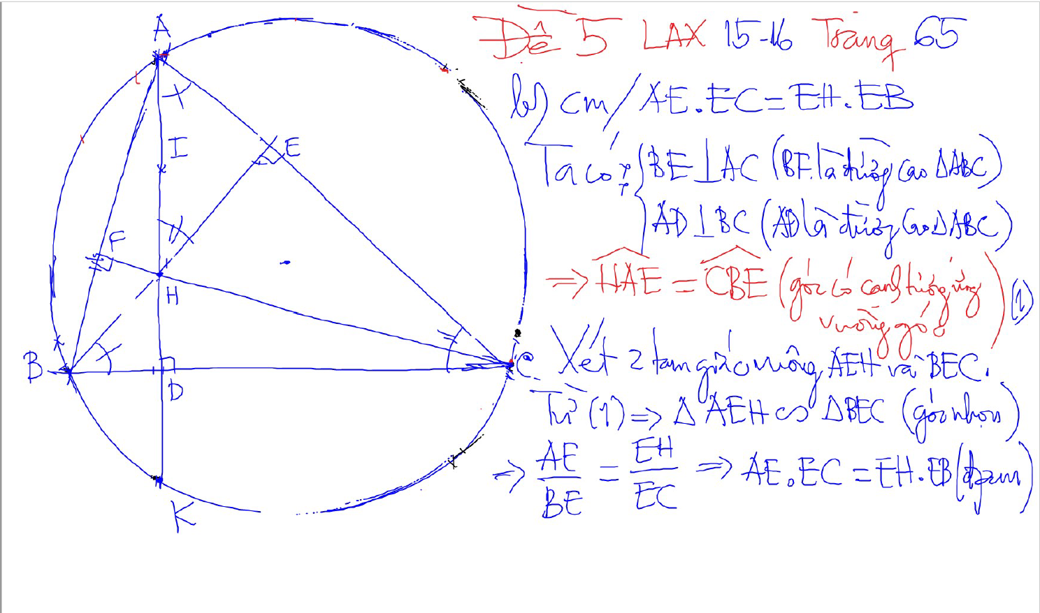
2 tam giac dong dang (truong hop 1)
2 goc bang nhau
1 goc nhon bang nhau

Slide 30
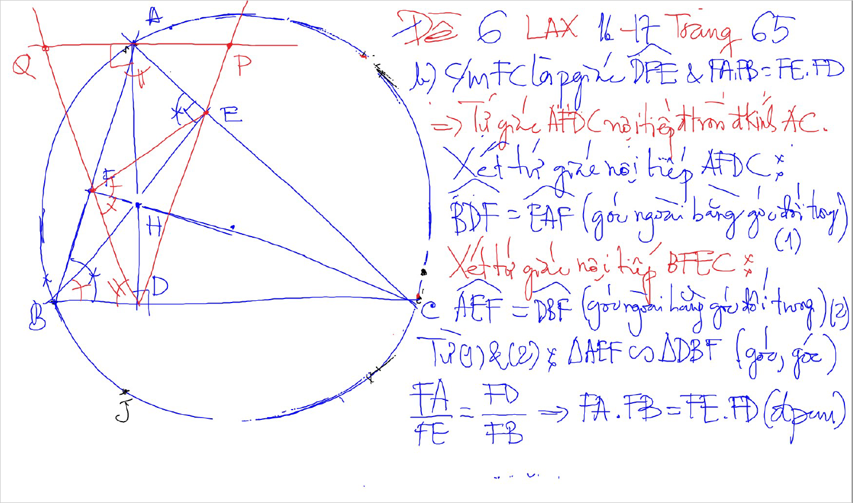
2 tam giac dong dang (truong hop 1)
2 goc bang nhau
1 goc nhon bang nhau

Slide 31
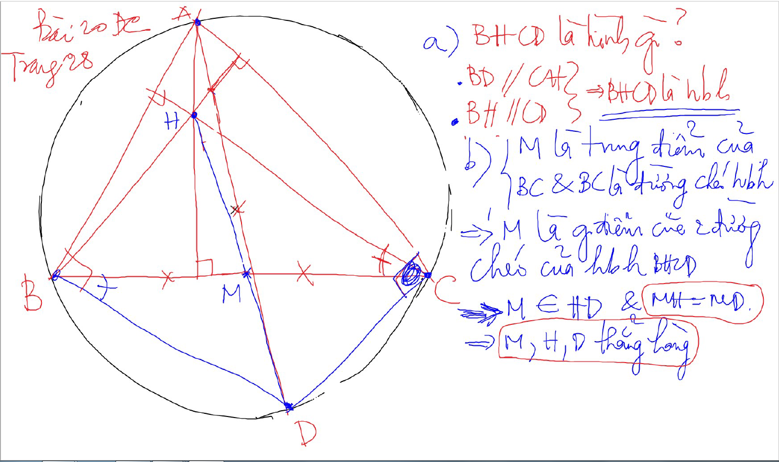

Slide 32
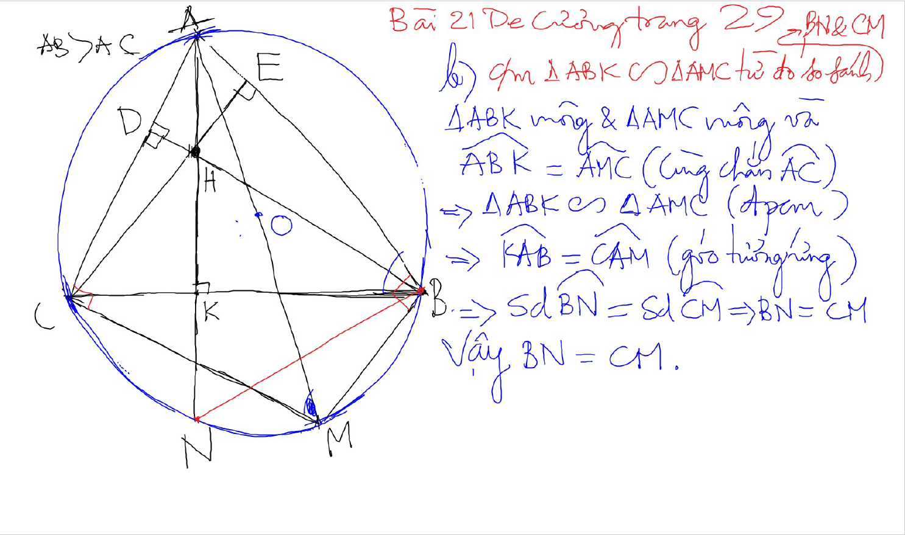

Slide 33
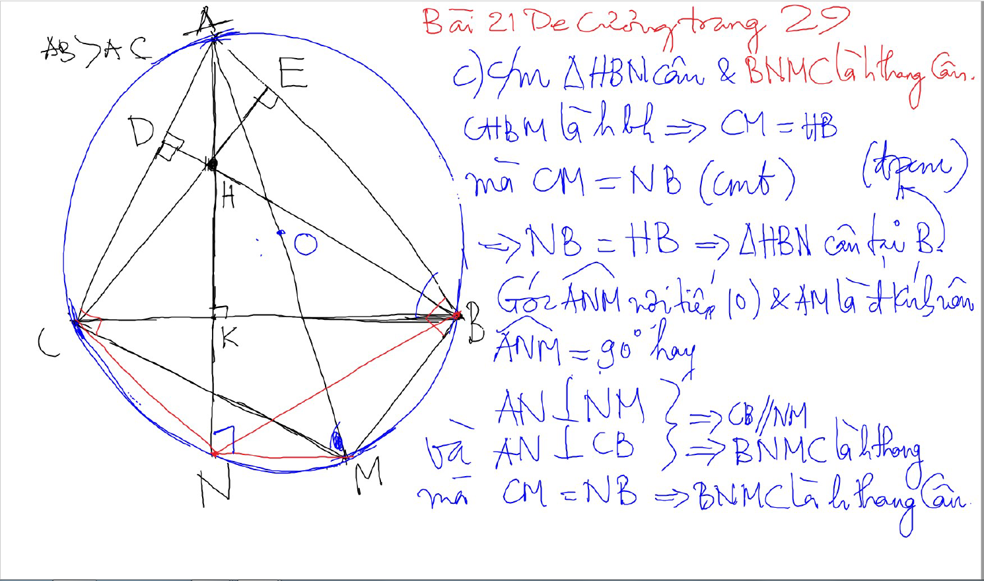

Slide 34
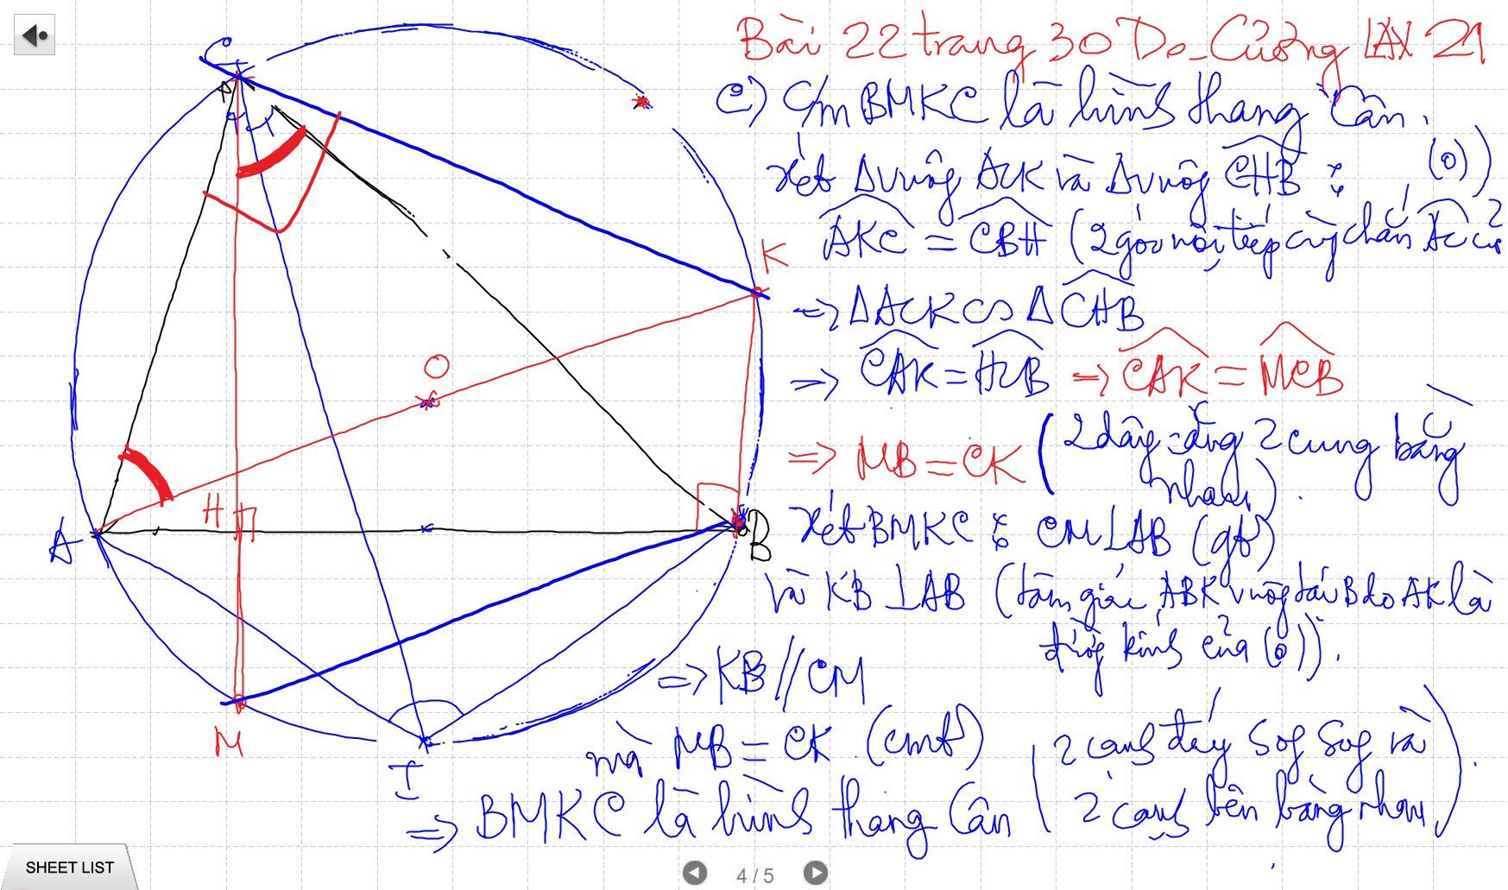

Slide 35
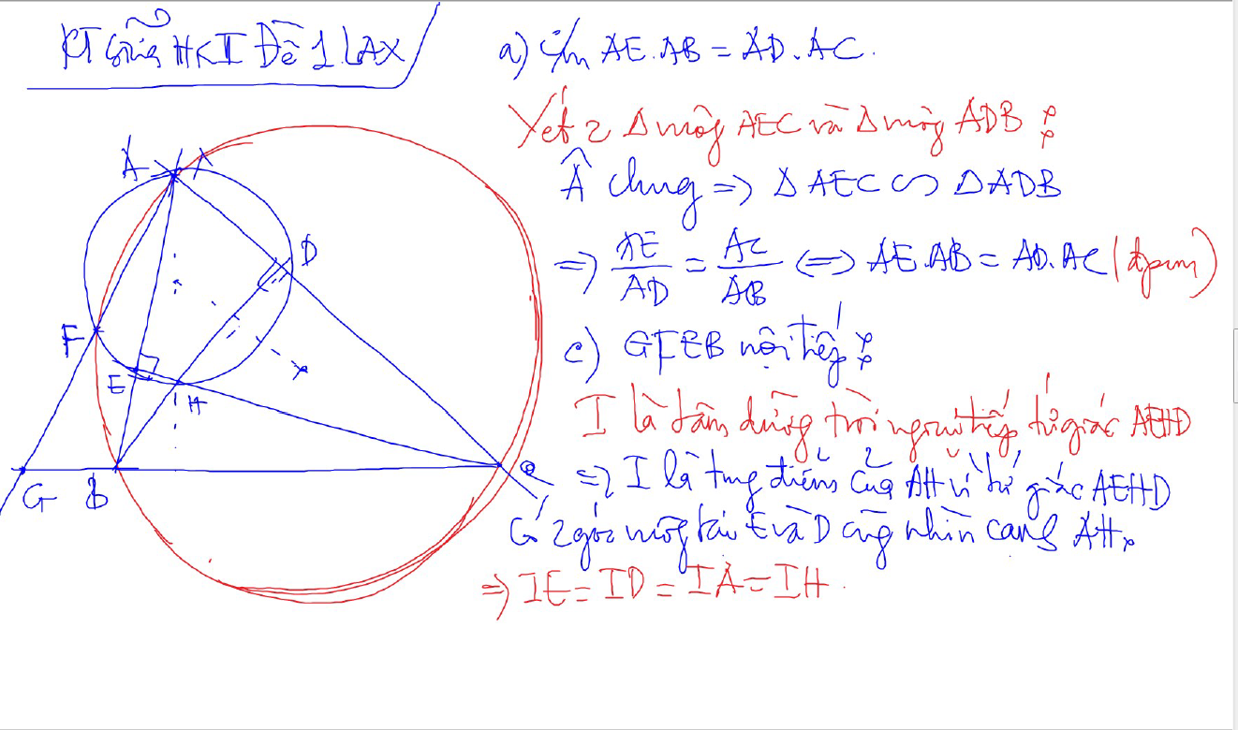

Slide 36
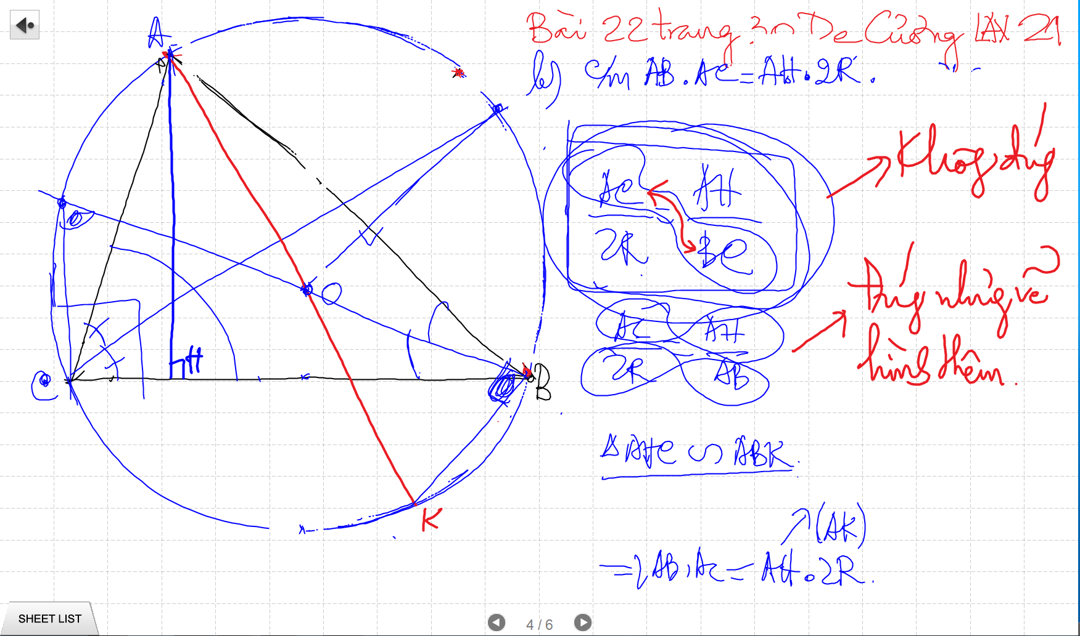

Slide 37
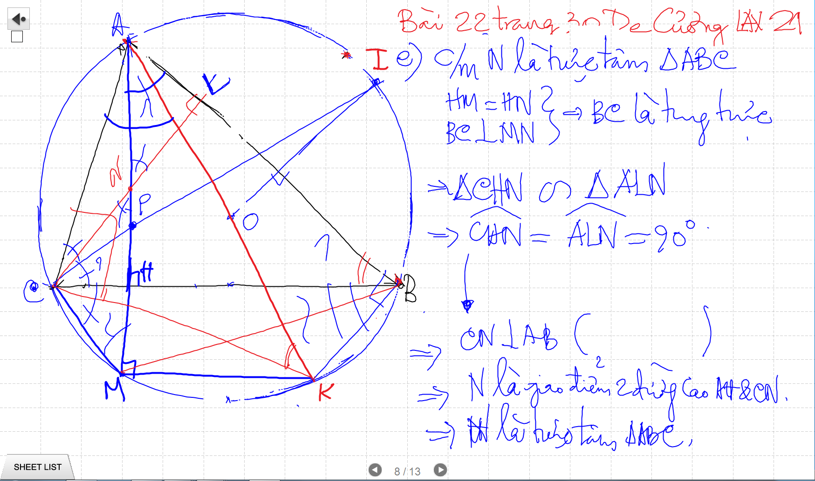

Slide 38
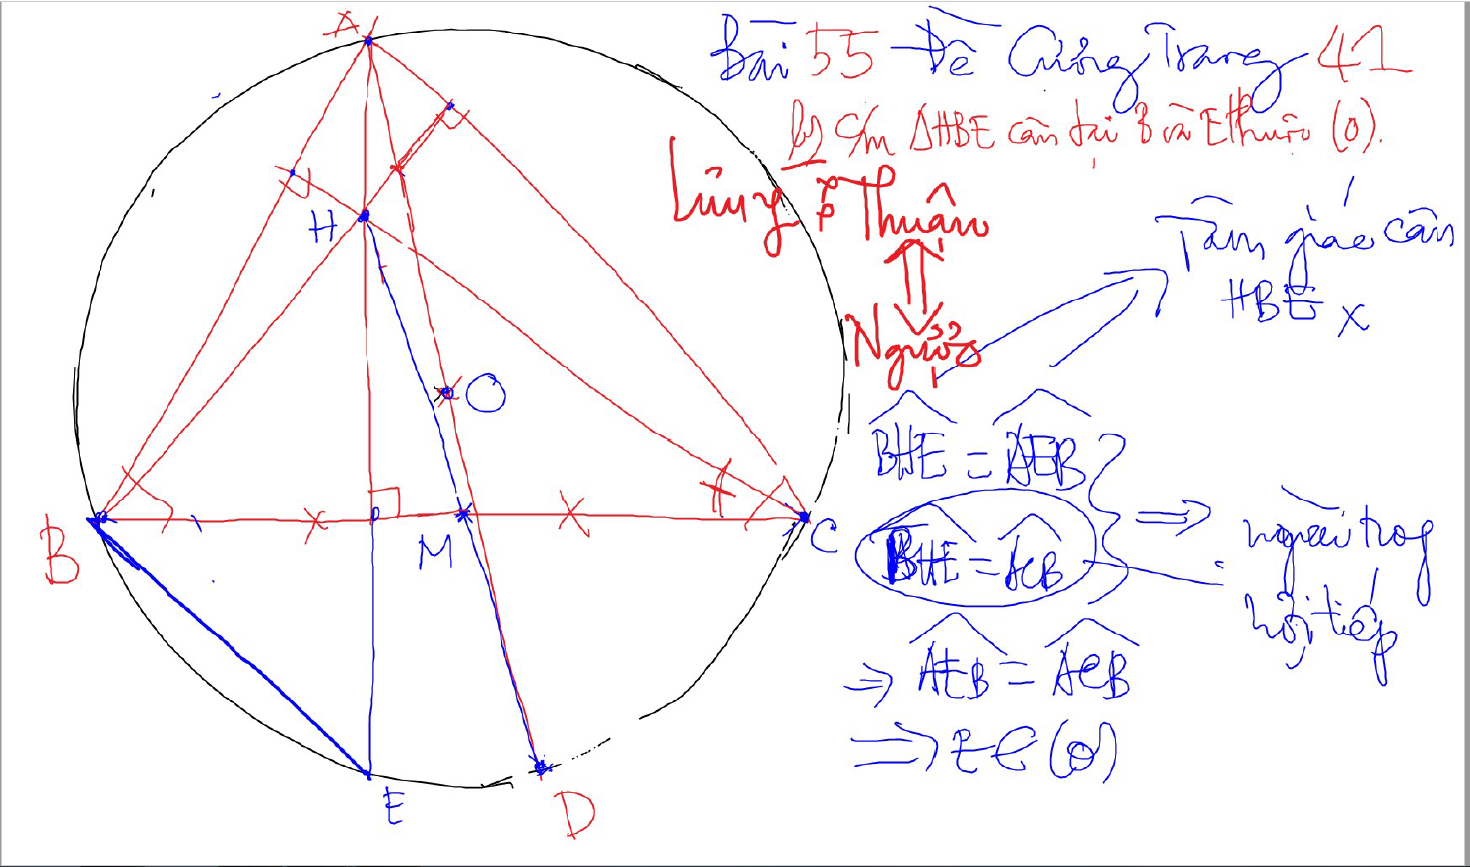

Slide 39
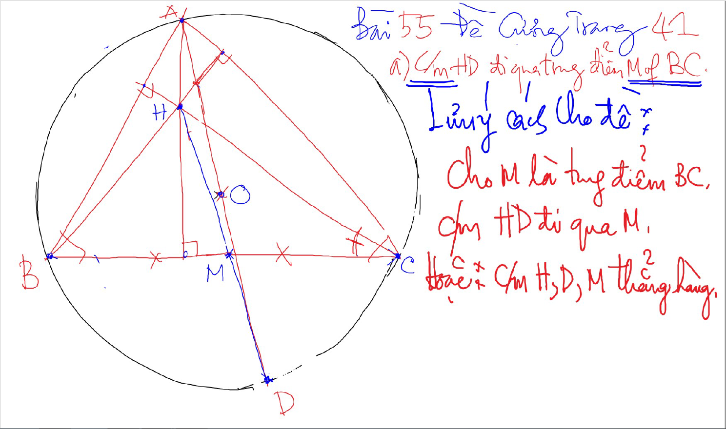

Slide 40
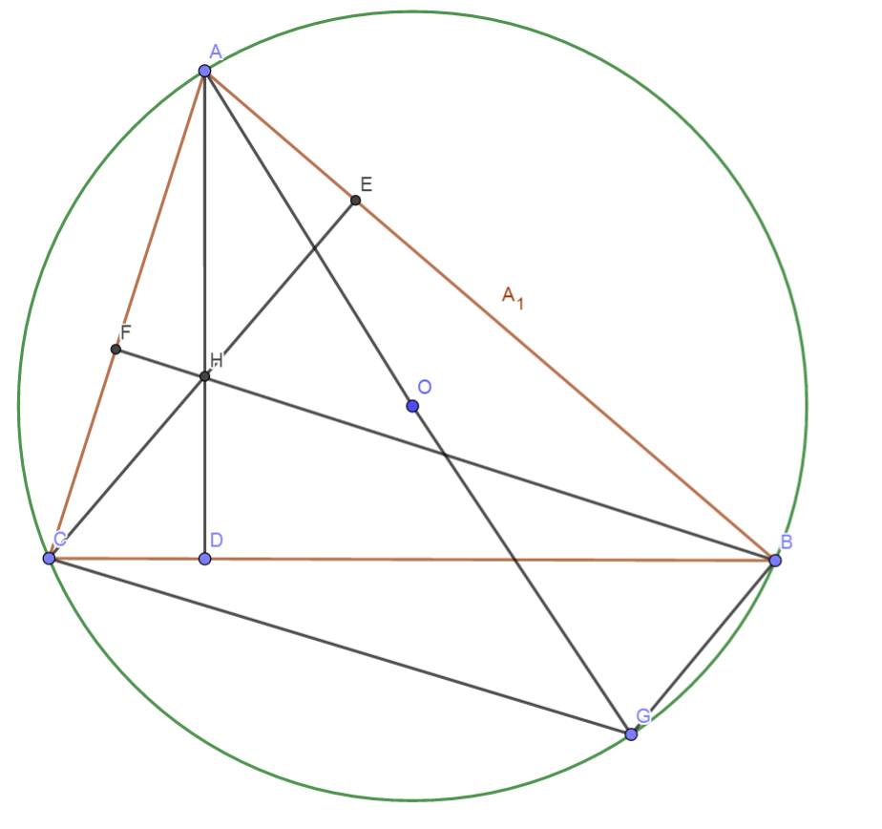
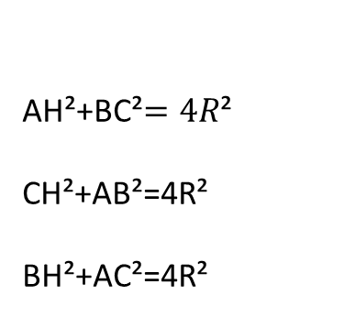
Quan he giua canh day va khoang cach den truc tam
AH²+BC²$=4R$²
CH²+AB²=4R²
BH²+AC²=4R²

Slide 41
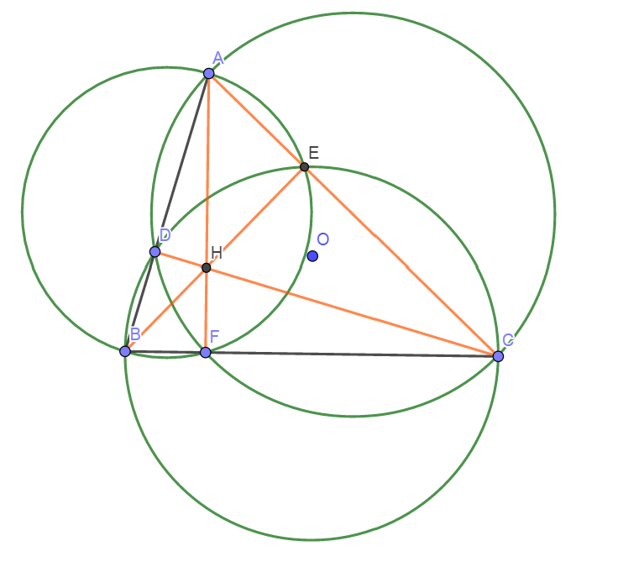
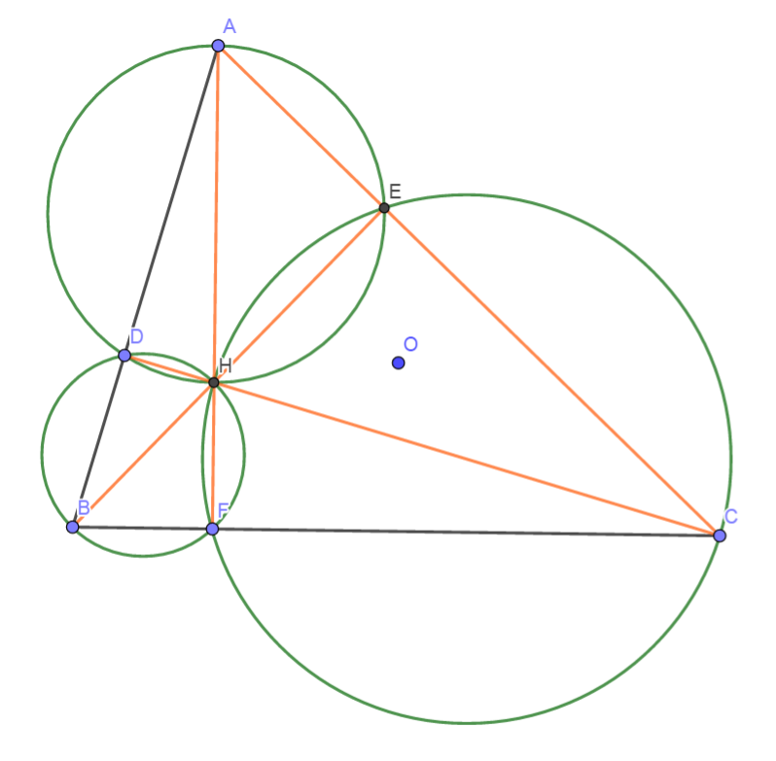
Truc Tam: 6 tu giac noi tiep

Slide 42
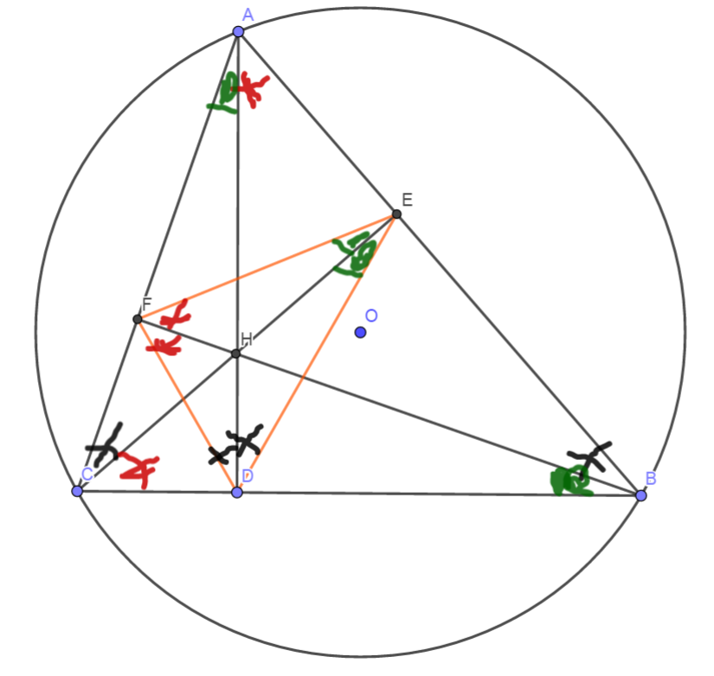
Truc tam: Tinh chat chan 3 duong cao
Chan 3 duong cao tao thanh tam giac DEF
3 duong cao cua tam giac ABC cung la 3 duong phan giac cua tam giac chan duong cao (DEF)
3 tam giac nho o 3 dinh (3 cai banh u) dong dang voi tam giac lon

Slide 43
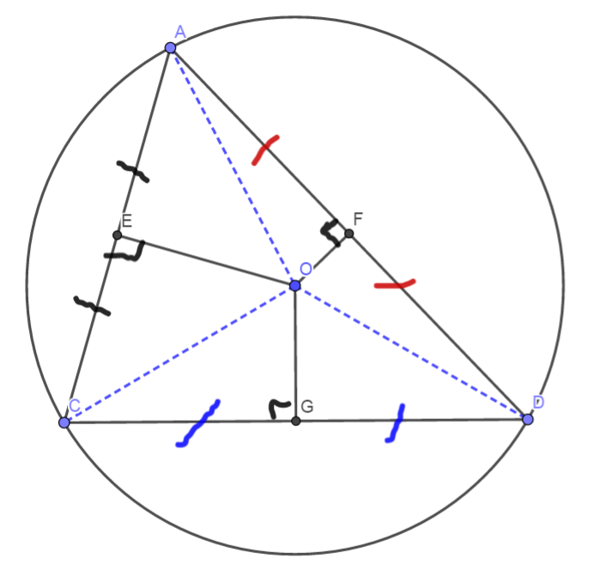
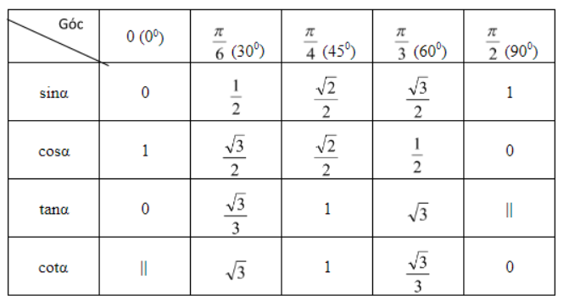
3 duong trung truc dong qui, la tam cua duong tron ngoai tiep tam giac
Giao diem cua 3 duong phan giac la tam duong trong noi tiep tam giac

Slide 44
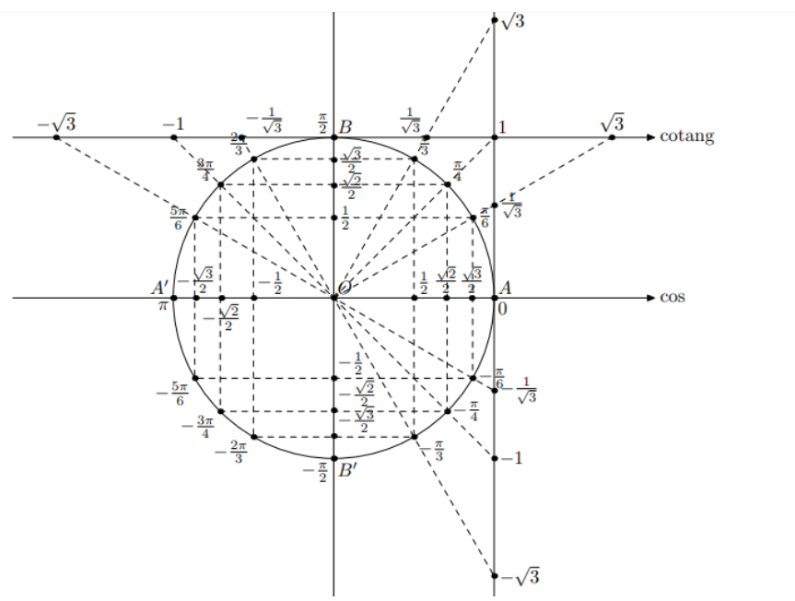

Slide 45
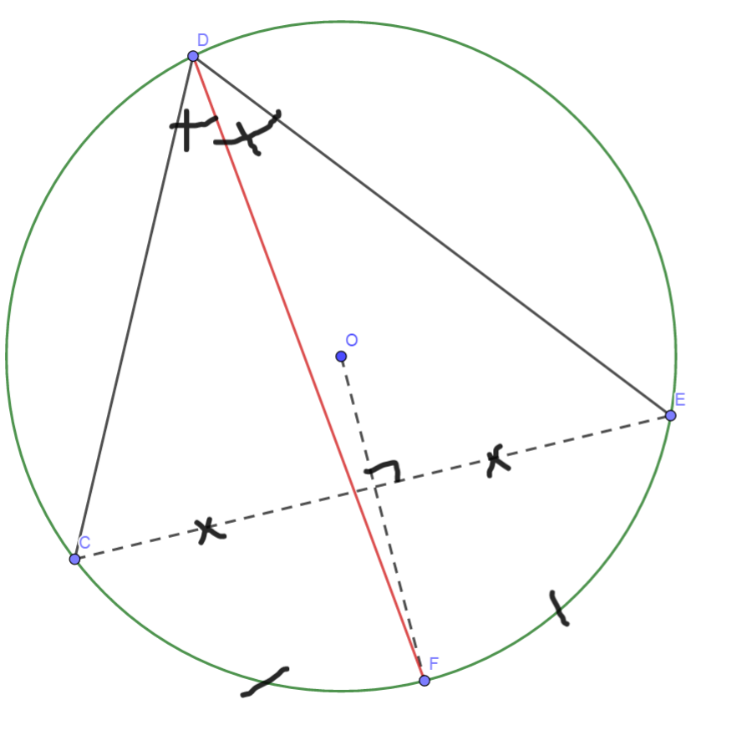
Cach ve duong phan giac cua goc noi tiep

Slide 46
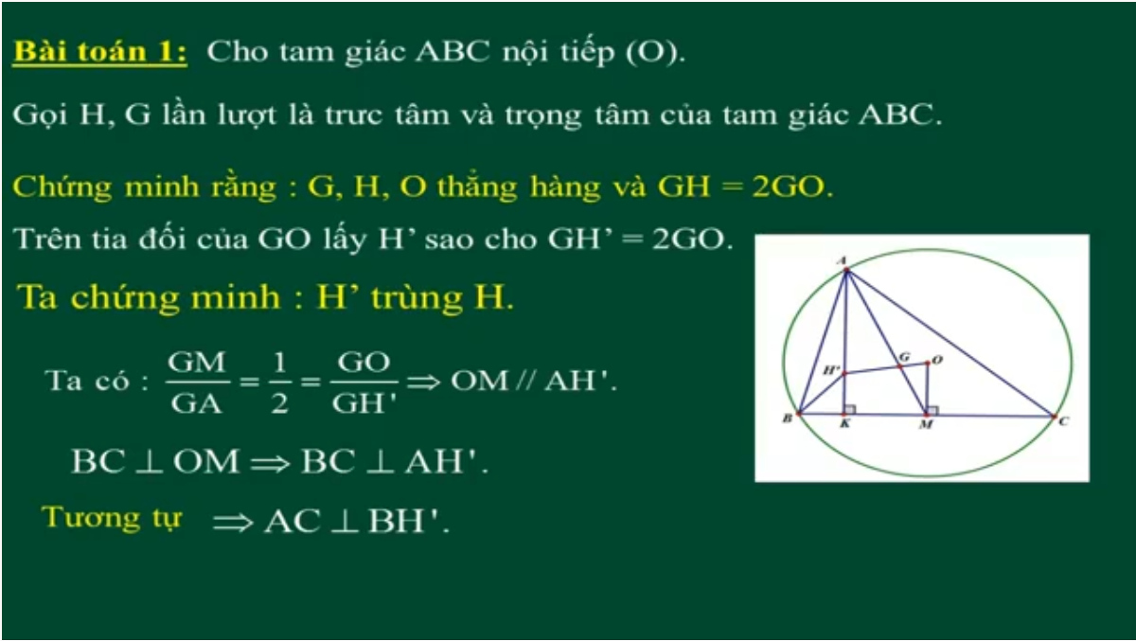
Cach ve duong phan giac cua goc noi tiep

Slide 47
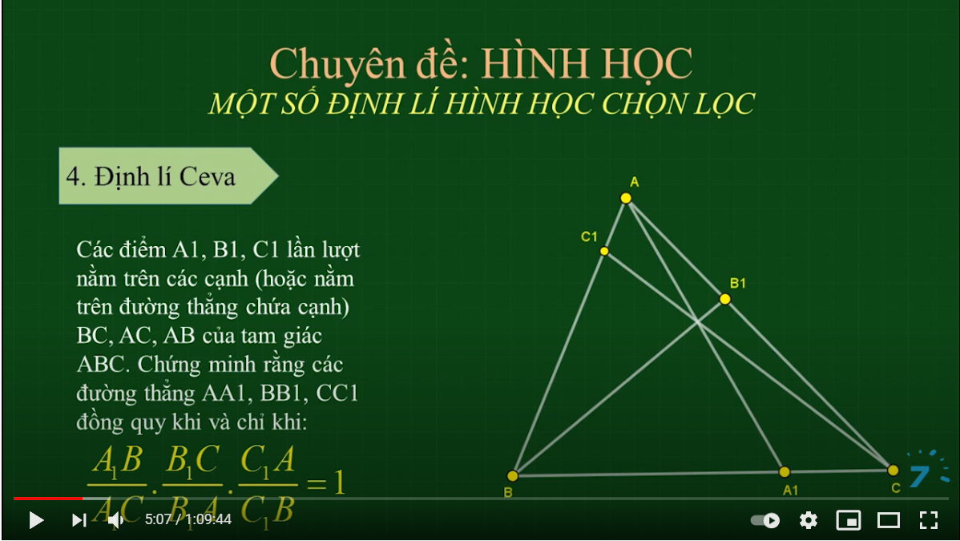
Cach ve duong phan giac cua goc noi tiep

Slide 48

Cach ve duong phan giac cua goc noi tiep

Slide 49

Cach ve duong phan giac cua goc noi tiep

Slide 50

C/m tam giac dong dang truong hop 2

